Slide 1
OMIS 351
Unit 4 (of 7)
IT Foundations II – Telecommunications and The Internet (and securing it all)

Slide 2
All telecommunications comes down to:
Processors
and Control
Software
Terminal
Media
Processors
and Control
Software
Terminal
Notes:
1
1

Slide 3
How are infrastructures established?
A quick look at Telecomm Basics.
POTS: “Plain Old Telephone Service”
Let’s talk:

Slide 4
I want to talk to someone else:

Slide 5
They want to talk to someone else
etc., etc.!!!:

Slide 6
Along comes the switch.
In Public Switched Telephone Network (PSTN, or sometimes “POTS”), this is basically the EXCHANGE (last 4 digits)
CO Switch
(aaa) ppp-XXXX

Slide 7
Switches in the same LATA (“Local Access and Transport Area”) are distinguished by PREFIX (first 3 digits).
(aaa) PPP-xxxx

Slide 8
Calls that cross a LATA boundary are distinguished by AREA CODE (numbers in parentheses). These are “long distance” calls.
LATA boundary
(AAA) ppp-xxxx

Slide 9
PSTN
These calls are all “circuit switched”
  Dedicated line.
  Comes from voice requirements.
Contrasts the Internet and Web which is “packet switched”.
  Messages can travel many paths.
  Comes from data requirements.

Slide 10
E-mail from Company A
to Company D:
Company B
01001
11001
W9
01011
11110
W7
W6
W8
Company A
Company D
W2
Internet Backbone
W1
W11
W12
W3
W5
W4
Company C
W10

Slide 11
E-mail from Company A
to Company D:
Company B
W9
W7
01001
W6
W8
Company A
Company D
11001
Internet Backbone
W1
W2
W11
W12
01011
11110
W3
W5
W4
Company C
W10

Slide 12
E-mail from Company A
to Company D:
broken into packets, that
travel the best path.
Company B
W9
W7
01011
W6
01001
Company A
W8
Company D
W2
Internet Backbone
W1
W11
W12
11110
W3
W5
11001
W4
Company C
W10

Slide 13
E-mail from Company A
to Company D:
packets reassembled at
the other end.
Company B
Of course, TCP/IP
is the dominant packet
switching protocol.
W9
W7
W6
W8
01001
Company A
Company D
Internet Backbone
11001
W1
W2
W11
W12
01011
11110
W3
W5
W4
Company C
W10

Slide 14
Putting it all together.
Companies A-D are all connected to the Internet,
Companies B & D are trading partners and are
connected through a WAN, and Consumers 1 & 2
are connected to the PSTN, and also to the
Internet through the PSTN. A "W" in a box
represents a Web server (thus, Company D's
Web server is "W12") .
Company B
W9
WAN
W7
W6
W8
Company A
Company D
W2
Internet Backbone
W1
W11
W12
W3
W5
W4
PSTN
Company C
Consumer 1
W10
Consumer 2

Slide 15
firewall, fiber, frame relay, TCP/IP, DSL, and modem?
Company B
W9
WAN
W7
W6
W8
Company A
Company D
W2
Internet Backbone
W1
W11
W12
W3
W5
W4
PSTN
Company C
Consumer 1
W10
Consumer 2

Slide 16
TRANSMISSION CONTROL PROTOCOL/INTERNET PROTOCOL (TCP/IP)
Transmission Control Protocol/Internet Protocol (TCP/IP) - a group, or suite, of networking protocols used to connect computers on the Internet
TCP and IP are the two main protocols in the suite
  TCP provides transport functions, ensuring, among other things, that the amount of data received is the same as the amount transmitted
  The IP part of TCP/IP provides the addressing and routing mechanism

Slide 17
Transmission Control Protocol/Internet Protocol (TCP/IP)
The TCP/IP suite of applications include:
  File Transfer Protocol (FTP) - allows files to be downloaded off or uploaded onto a network
  Simple Mail Transfer Protocol (SMTP)-TCP/IP’s own messaging system for e-mail
  Telnet protocol - provides terminal emulation
  Hypertext Transfer Protocol (HTTP) - allows Web browsers and servers to send and receive Web pages
  Simple Network Management Protocol (SNTP) - allows the management of networked nodes to be managed from a single point

Slide 18
What about wireless?
“Cells”
Base Stations
“Mobile Telephone
Switching Office”
MTSO
PSTN
Mobile
Units
Other
Base
Stations
MTSO

Slide 19
Notes:
12
12

Slide 20
Analog vs. Digital
Expense of cellular phone use continues to come down as the transition is made.
Analog Signal
Digital Signal
Notes:
13
13

Slide 21
1G, 2G, 3G, 4G, 5G?
Here “G” is for “Generation”
Analog is 1G, digital is 2G
3G: Intended for the true multimedia cell phone -- typically called smartphones -- and features increased bandwidth and transfer rates to accommodate Web-based applications and phone-based audio and video files.

Slide 22
1G, 2G, 3G, 4G, 5G?
Here “G” is for “Generation”
3G networks have potential transfer speeds of up to 3 Mbps (about 15 seconds to download a 3-minute MP3 song). For comparison, the fastest 2G phones can achieve up to 144Kbps (about 8 minutes to download a 3-minute song).
        Source: HowStuffWorks.com

Slide 23
1G, 2G, 3G, 4G, 5G?
Here “G” is for “Generation”
A 4G (LTE = “Long Term Evolution”) system may upgrade existing communication networks and is expected to provide a comprehensive and secure IP based solution where facilities such as voice, data and streamed multimedia will be provided to users on an "Anytime, Anywhere" basis and at much higher data rates compared to previous generations.
1 Gbit/s download goal!
    Source: Wikipedia.org
completed by April 2019 to accommodate the early commercial deployment

Slide 24
1G, 2G, 3G, 4G, 5G?
Here “G” is for “Generation”
5G: “5G performance targets high data rate, reduced latency, energy saving, cost reduction, higher system capacity, and massive device connectivity”
First phase completed April 2019. Speeds up to 20 Gbps (may compete with existing ISPs)
Current 4G cellphones will not be able to use the new networks, which will require new 5G enabled wireless devices.
To ensure wide service, 5G networks operate on up to three frequency bands: low, medium, and high.
Source: Wikipedia.org

Slide 25
SPEEDS & COST OF MEDIA
MEDIUM
SPEED
COST
TWISTED WIRE
300 BPS - 10 MBPS
LOW
MICROWAVE
256 KBPS - 100 MBPS
SATELLITE
256 KBPS - 100 MBPS
COAXIAL CABLE
56 KBPS - 200 MBPS
FIBER OPTICS
500 KBPS - 10 GBPS
HIGH
BPS: BITS PER SECOND
KBPS: KILOBITS PER SECOND
MBPS: MEGABITS PER SECOND
GBPS: GIGABITS PER SECOND

Slide 26
Notes:
9
8

Slide 27
What if one or more of the “terminals” is a computer?
Modems - the most popular “processor” - convert computer language (digital) into POTS transmittable language (analog).
Analog Signal
Digital Signal
Notes:
14
15

Slide 28
The Modem Conversion
Analog to Digital....Modulation
0001 0101
Modulate - Convert Digital to Analog
Demodulate - Convert Analog to Digital
Modem - Modulator/Demodulator
0001 0101
Notes:
15

Slide 29
Telecommunications Infrastructure
Satellite
Microwave
Link
Microwave
Link
Earth
Station
Earth
Station
Multiplexer
Satellite
Regional
Office
Modem
Satellite
Central
Office
Fiber
optic
cable
Coaxial
cable
Wireless
LAN
Gateway
Host
Computer
Multiplexer
End User Workstation
Notes:
21

Slide 30
Computers are beginning to dominate our concept of “networks”
Local Area Network (LAN).
Wide Area Network (WAN).
Metropolitan Area Network (MAN).
Global Area Network (GAN).
Notes:
16
16

Slide 31
Topologies and Protocols
Topology: the structure. Star, ring, and bus.
Protocol: the standard. Applies to a variety of different areas (cabling, transmission, etc.). Ethernet is a popular protocol for LANs, and TCP/IP for the Internet, and GSM for cell phones.
Notes:
22
22

Slide 32
INTRANET
INTERNAL NETWORK
WWW TECHNOLOGY
FIREWALL: Security System to Prevent Invasion of Private Networks
OVERCOMES COMPUTER PLATFORM DIFFERENCES
OFTEN INSTALLED ON EXISTING NETWORK INFRASTRUCTURE
*

Slide 33
EXTRANET
ALLOWS SELECT USERS OUTSIDE ORGANIZATION TO USE ITS INTRANET:
CUSTOMERS
BUSINESS PARTNERS
VENDORS
*

Slide 34
EXTRANET

Slide 35
Virtual Private Network (VPN)
Virtual private network (VPN) - a private WAN that uses the Internet as a low-cost WAN backbone to transport data between tow or more geographically separate sites
Advantages that a VPN has over a dedicated-line WAN:
  The cost of implementation
  No need to lay cable or lease dedicated lines between the remote sites needing to connect
  Additional Internet connection would be required
  Businesses can network remote offices into one large WAN and provide access to the Internet

Slide 36
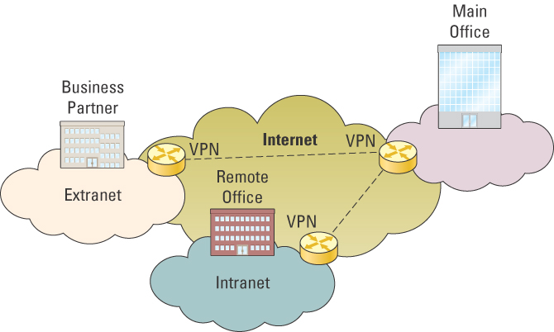
Virtual Private Network (VPN)
Intranet, Extranet, and VPN Technologies

Slide 37
The Internet
Network of Networks, established in 1969 by U. S. Defense Dept. for research.
Number of users doubling each year for most of middle to late 90s. Now doubles about every two years. “.com” s have taken over.
No central authority, originally for nuclear disaster reasons. Taxes, gambling, etc.?
E-mail, Usenet, FTP, telnet: WWW has all of these.
Notes:
23

Slide 38
What is the Internet?
client
A Physical Entity...
a collection of thousands of computer networks
server
client
client
client
client
server
main
frame
client
main
frame
client
client
client
server
server
client
client
client
Notes:
24

Slide 39
What is the Internet?
client
Recognized Standards (TCP/IP)
protocols for transferring information across
various computer platforms
server
Apple
Talk
client
client
client
client
IBM
Windows
server
main
frame
Vax VMS
client
main
frame
client
client
IBM VM/CMS
client
Sun
Unix
server
server
IBM
Windows
client
client
client
Notes:
26

Slide 40
Net Neutrality
Reclassifying broadband access as a telecommunications service and thus applying Title II (common carrier) of the Communications Act of 1934 to Internet service providers.
In Plain English: All Internet traffic should be treated equally.

Slide 41
How many Users?
147 Million as of 9/98, 195 million as of 8/99, 378 million as of 9/00, 580 million as of 5/02, 1.08 billion as of 2005, 1.83 billion as of 2010, 3.2 billion as of 2015, 3.6 billion in June 2016, and ONWARD!!
4.7 billion in May 2020 (60% of world population)
(http://www.internetworldstats.com/stats.htm)

Slide 42
How many Servers?
(sites being served)
3.2 Million as of 9/98, 7 Million as of 8/99, 21 Million as of 9/00, 37 Million as of 7/02, 143 million as of 10/07, 206 million as of 3/10, 878 million as of 2015, 1.15 billion as of August 2016, 1.2 billion as of May 2020 and ONWARD!!
www.survey.netcraft.com

Slide 43
Getting Around the WWW
IP Address. Four-part numeric address for any device connected to the Internet. Only a few billion possibilities. IPng on its way - trillion.
DNS: Domain Name System. Translates IP into meaningful site name and vice versa. TLD, or “top level domains”, are things like “.com”. In the ballpark of $9 (and increasingly less) a year for registration.

Slide 44
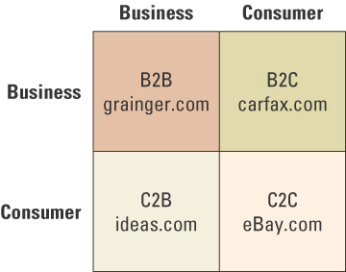
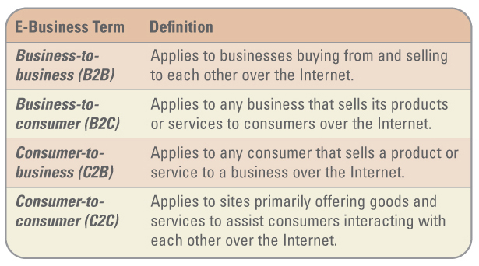
THE IMPORTANCE OF THE E-BUSINESS MODEL
Basic Internet
business models
Notes:
Building a Web site does not mean that customers will come
Traditional means of customer acquisition such as advertising, promotions, and public relations are just as important with a Web site
Once customers are attracted, a Web site must create a “buzz”
Discuss the Fruit of the Loom (FOL) example on page 139
Class Activity: Ask your students to compile a list of several examples of each type of e-business model
Ans: B2B: grainger.com
B2C: carfax.com
C2B: ideas.com
C2C: eBay.com

Slide 45
CHALLENGES OF THE E-BUSINESS MODELS
Three primary challenges include:
  Security concerns
    60% of Internet users consider the Internet unsafe
  Taxation
    Internet remains free of traditional forms of taxation
  Consumer protection
    Unsolicited goods and communications
    Illegal or harmful goods, services, and content
    Insufficient information about goods or their suppliers
    Invasion of privacy
    Cyberfraud
Notes:
Ask your students to identify additional challenges for e-business models? Ans: High cost of developing a dynamic Web site

Slide 46
Security:
How do we protect all of this information?
Notes:
13

Slide 47
Standard Example
If I get 7.5% interest on $5,349.44, how much do I get in a month?
(.075/12) = .00625 * 5,349.44 = $33.434
What happens to the .004?
.004+.004+.004=.012
.004 * 1,000,000 customers * 12 months = $48,000!!!!! Nice income supplement.
Notes:
14

Slide 48
Computer Crime
Computer crime losses estimated between $15-$300 Billion annually.
“The playground bullies are learning how to type” -- Forbes Magazine.
Notes:
15

Slide 49
BUT, crime is not the only security area!
Three main concerns:
  evil (crime)
  system limitations
  Carelessness / Stupidity
Notes:
16

Slide 50
Text example - TJX
Business establishments are increasingly under risk of information security threats
  Network in TJX retail store was infiltrated via an insecure Wi-Fi base station
  45.7 million credit and debit card numbers were stolen
  Driver’s licenses and other private information pilfered from 450,000 customers
  TJX suffered under settlement costs and court-imposed punitive action to the tune of $150 million

Slide 51
The TJX Breach
Factors that amplified severity of TJX security breach are:
  Personnel betrayal: An alleged FBI informant used insider information to mastermind the attacks
  Technology lapse: TJX used WEP, a insecure wireless security technology
  Procedural gaffe: TJX had received an extension on the rollout of mechanisms that might have discovered and plugged the hole before the hackers got in

Slide 52
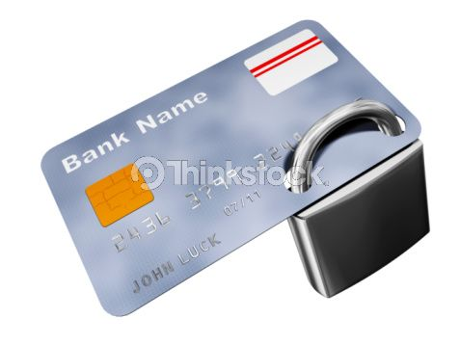
Lessons Learned
Information security must be a top organizational priority
Information security isn’t just a technology problem; a host of personnel and procedural factors can create and amplify a firm’s vulnerability
A constant vigilance regarding security needs to be part of individual skill sets and a key component of organizations’ culture
Item number: 95409048

Slide 53
The First Line of Defense - People
Organizations must enable employees, customers, and partners to access information electronically
The biggest issue surrounding information security is not a technical issue, but a people issue
33% of security incidents originate within the organization
  Insiders – legitimate users who purposely or accidentally misuse their access to the environment and cause some kind of business-affecting incident
Notes:
Most information security breaches result from people misusing an organization's information either advertently or inadvertently.
For example, many people freely give up their passwords or write them on sticky notes next to their computers, leaving the door wide open to intruders
Class Activity: Ask your students to research the Internet to find the latest version of the CSI/FBI Computer Crime and Security Survey to find the newest information on computer crime and security breeches

Slide 54
The First Line of Defense - People
The first line of defense an organization should follow to help combat insider issues is to develop information security policies and an information security plan
  Information security policies – identify the rules required to maintain information security
  Information security plan – details how an organization will implement the information security policies
Notes:
Have your students to review the sample information security plan (Figure B1.1) located on page 221
Class Activity: Break your students into groups and ask them to research and review your school’s information security plan
What did the plan address that your students found surprising?
What is the plan missing or failing to address?
If your students were responsible for updating the plan, what would they add?

Slide 55
The First Line of Defense - People
Hackers frequently use “social engineering” to obtain password
  Social engineering – using one’s social skills to trick people into revealing access credentials or other information valuable to the attacker
Notes:
Review the example on page 222 of the director of a large health care company who hired outside auditors to find information security breaches
Ask your students to share any experiences they have had with social engineering through stolen passwords or identity theft

Slide 56
The Second Line of Defense - Technology
Three primary information security areas:
  Authentication and authorization
  Prevention and resistance
  Detection and response
Notes:
Discuss the ASU example on page 223

Slide 57
AUTHENTICATION AND AUTHORIZATION
Authentication – a method for confirming users’ identities
The most secure type of authentication involves a combination of the following:
  Something the user knows such as a user ID and password
  Something the user has such as a smart card or token
  Something that is part of the user such as a fingerprint or voice signature
Notes:
Ask your students what types of authentication they are using today
What type is used at their bank?
What type is used for their online banking?
Is it secure? Why or why not?

Slide 58
Something the User Knows such as a User ID and Password
This is the most common way to identify individual users and typically contains a user ID and a password
This is also the most ineffective form of authentication
Over 50 percent of help-desk calls are password related
Notes:
Have any of your students ever had their authentication method hacked? What was the outcome?

Slide 59
Something the User Has such as a Smart Card or Token
Smart cards and tokens are more effective than a user ID and a password
  Tokens – small electronic devices that change user passwords automatically
  Smart card – a device that is around the same size as a credit card, containing embedded technologies that can store information and small amounts of software to perform some limited processing
Notes:
Smart cards can act as identification instruments, a form of digital cash, or a data storage device with the ability to store an entire medical record

Slide 60
Something That Is Part of the User such as a Fingerprint or Voice Signature
This is by far the best and most effective way to manage authentication
  Biometrics – the identification of a user based on a physical characteristic, such as a fingerprint, iris, face, voice, or handwriting
Unfortunately, this method can be costly and intrusive
Notes:
How many of your students would like to have an iris scan performed each time they entered your classroom?

Slide 61
PREVENTION AND RESISTANCE
Downtime can cost an organization anywhere from $100 to $1 million per hour. Perform automatic updates and keep your patches current!
Technologies available to help prevent and build resistance to attacks include:
  Content filtering
  Encryption
  Firewalls
Notes:
Discuss the Sony example on page 225
Discuss the eBay network operation failure on page 225
Ask your students how much it would cost eBay or Amazon.com if their systems were down for one day
One 22-hour outage in June 2000 caused eBay’s market cap to plunge $5.7 billion

Slide 62
Content Filtering
Organizations can use content filtering technologies to filter e-mail and prevent e-mails containing sensitive information from transmitting and stop spam and viruses from spreading.
  Content filtering – occurs when organizations use software that filters content to prevent the transmission of unauthorized information
  Spam – a form of unsolicited e-mail
Notes:
Ask your students how many spam messages they receive each day
What types of preventative measures have they taken to stop spam
Ask your students how many use antivirus software. More importantly, how many have current, up-to-date antivirus software, and how frequently do they actually run it and scan their computers for viruses
Ask your students to research the Internet and find several different spam filters and antivirus software that they could use

Slide 63
ENCRYPTION
If there is an information security breach and the information was encrypted, the person stealing the information would be unable to read it
  Encryption – scrambles information into an alternative form that requires a key or password to decrypt the information
Notes:
Ask your students if they know that when they send an e-mail it can easily be read by:
Anyone who works for the Internet service provider
Anyone who works for the recipient's Internet service provider
Anyone who operates any of the perhaps dozens of Internet routers that the data packets will pass through
Anyone with physical access to the telephone switching equipment in the phone company's office
Do your students know that if they speak on the telephone with anyone in the United States, the telephone switching equipment at the phone company offices has wiretaps built into it for easy access by authorities - or actually anyone with the password, such as maintenance personnel? These wiretaps started appearing after the U.S. Congress passed the Digital Telephony Act, because of complaints by law enforcement that modern digital telephone systems were becoming harder to tap.
Ask your students how long they think it would take a hacker to break an encryption code. Many hundreds of years.
Have your students research the Web to find information about encryption technologies they can use to protect their sensitive information

Slide 64
SECURITY AND THE INTERNET
PUBLIC KEY ENCRYPTION
SENDER
SCRAMBLED MESSAGE
RECIPIENT
Encrypt with public key
Decrypt with private key

Slide 65
FIREWALLS
One of the most common defenses for preventing a security breach is a firewall
  Firewall – hardware and/or software that guards a private network by analyzing the information leaving and entering the network
Notes:
A firewall examines each message that wants entrance to the network, and unless the message has the correct marking, the firewall prevents it from entering the network
Ask your students what would happen to an organization that did not have firewalls at the entrance of its networks
Ans: This organization’s servers would not be operating for long because they would be hacked by every hacker around

Slide 66
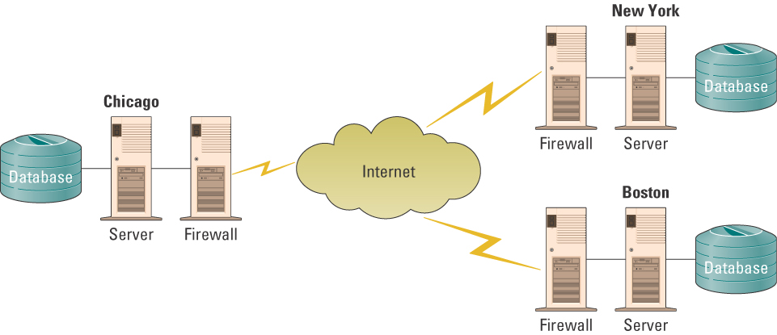
FIREWALLS
Sample firewall architecture connecting systems located in Chicago, New York, and Boston
Notes:
A firewall examines each message that wants entrance to the network, and unless the message has the correct marking, the firewall prevents it from entering the network
Point out to your students the placement of the firewalls between the servers and the Internet

Slide 67
DETECTION AND RESPONSE
If prevention and resistance strategies fail and there is a security breach, an organization can use detection and response technologies to mitigate the damage
Antivirus software is the most common type of detection and response technology
Notes:
Discuss the Jeffrey Parson worm example on page 226

Slide 68
DETECTION AND RESPONSE
Some of the most damaging forms of security threats to e-business sites include:
  Malicious code – includes a variety of threats such as viruses, worms, and Trojan horses
  Hoaxes – attack computer systems by transmitting a virus hoax, with a real virus attached
  Spoofing – the forging of the return address on an e-mail so that the e-mail message appears to come from someone other than the actual sender
  Sniffer – a program or device that can monitor data traveling over a network
Notes:
Some of the most damaging forms of security threats to e-business sites include malicious code, hoaxes, spoofing, and sniffers

Slide 69
Providing Security - Procedural
Keep an electronic audit trail
Separate duties.
Never allow too much power to one individual. In ES, don’t allow the expert to update the knowledge base.
Continually asses threats, risks, exposures, and vulnerabilities.
Have standard procedures and documentation.
Strict authorization requirements.
Notes:
20

Slide 70
Providing Security - Procedural
Outside audits.
“Security is everybody’s business” -- give awards, etc.
Have a disaster recovery plan. Lacked by 60% of all businesses!
Use intelligent systems capability of firm to flag problems.
Notes:
21

Slide 71
Providing Security - Physical
All hard drives will eventually crash. This fact should be your first to consider. Everything else doesn’t count if you’ve forgotten this.
Secure systems physically.
Separate systems physically.
Have off site storage.
Backups -files more than programs.
Fault tolerance - UPS.
Notes:
22

