Slide 1
OMIS 351
Unit 1 (of 7)
Solving Business Process Problems with Information Technology

Slide 2

Technology: GROWING IMPORTANCE
All modern managerial disciplines have been impacted by technology.
Tech knowledge has become a key differentiator for a job seeker.
With computing getting cheaper and faster, it is being used everywhere.

Slide 3

What are analysts’ thoughts on Information and Big Data?
Information is the oil of the 21st century, and analytics is the combustion engine.– Gartner
The world’s most valuable resource is no longer oil, but data. – The Economist
Big Data is a collection of data from traditional and digital sources inside and outside your company that represents a source for ongoing discovery and analysis.– Forbes

Slide 4


The population of the world is 7 billion; 6 billion people have cell phones: a source of huge volumes of data and process changes (doing things faster, cheaper and better!)

Slide 5
…but problems persist: The “HI-TECH Act”
The American Recovery and Reinvestment Act of 2009 was signed by President Obama on February 17, 2009.
The Act includes the Health Information Technology for Economic and Clinical Health Act (HITECH Act).
The purpose of the HITECH Act is to promote the use of health information technology with a goal of utilization of an electronic health record for each person in the United States by 2014. (Guess what? We’re WAY past 2014!!!).

Slide 6
Starting in 2015, hospitals and doctors were subject to financial penalties under Medicare if they were not using electronic health records.
Doctors who did not adopt an EHR by 2015 are being penalized 1% of Medicare payments, increasing to 3% over 3 years.
In order to receive the EHR stimulus money, the HITECH act requires doctors to show "meaningful use" of an EHR system.

Slide 7
You, too, can invent “sliced bread”!!!!
The guy who invented sliced bread… he didn’t invent slicing, and he didn’t invent bread… he just MADE THE MATCH.
What this means: You see an application for technology to a business problem.
  You don’t have to invent the technology or implement it.
  You have to understand how it works and its promise.

Slide 8
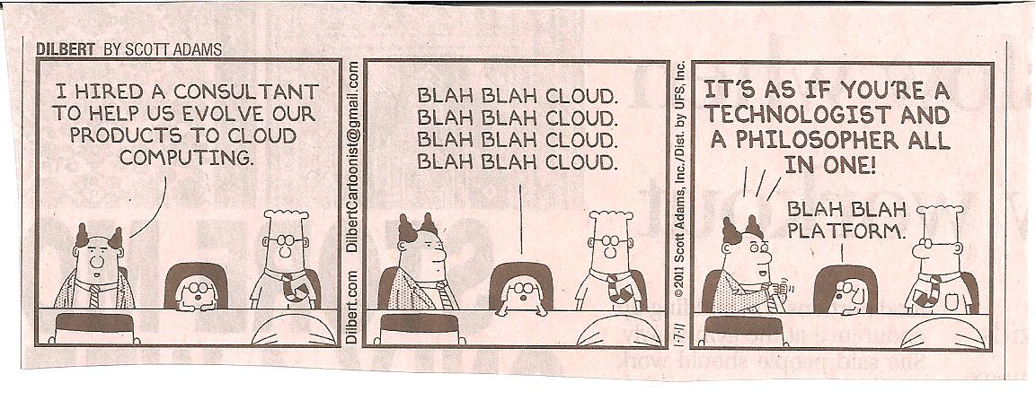

Slide 9
Managing in the Information Age
Information Age - What is it?
In Contrast to: Computer Age.
  Damaging fascination
  Easy to understand
Notes:
1

Slide 10
Movement Into Information Age
Exciting and frightening
Nearly all theories and constructs currently used developed since 1976
Notes:
2

Slide 11
Examples: Things to Watch For
E-Commerce flipping business models upside down.
Telecommunications Revolution.
Loan processing: 7 days to 15 minutes.
Frootloops every Wednesday.
etc., etc.
YOU have to be ready to deal with this!
Notes:
3

Slide 12
Technical
Specialists
Notes:
4

Slide 13
Senior
Management
Notes:
5

Slide 14
Who’s more valuable to the business?
Senior
Management
Technical
Specialists
Notes:
6

Slide 15
Goal of IS in OMIS (351 starts it
all off!):
Senior
Management
Technical
Specialists
YOU
Notes:
7

Slide 16




Got Tech?
Finance: No other industry impacts financial markets more than tech.
Accounting: Want to be a good auditor? Find out where the numbers came from.
Marketing: Internet advertising, multi-channel marketing, data mining, and customer-relationship management - modern marketing is all about tech.
Operations: Want to propose workable process improvements? You'll need to understand tech to do it.

Slide 17
What if you see a “slicing-bread” opportunity?
Managing technology projects and implementation: The “Systems Development Life Cycle” or SDLC.
What is the SDLC? A set of steps, or things you need to think about, when moving from the idea stage to the reality stage.

Slide 18
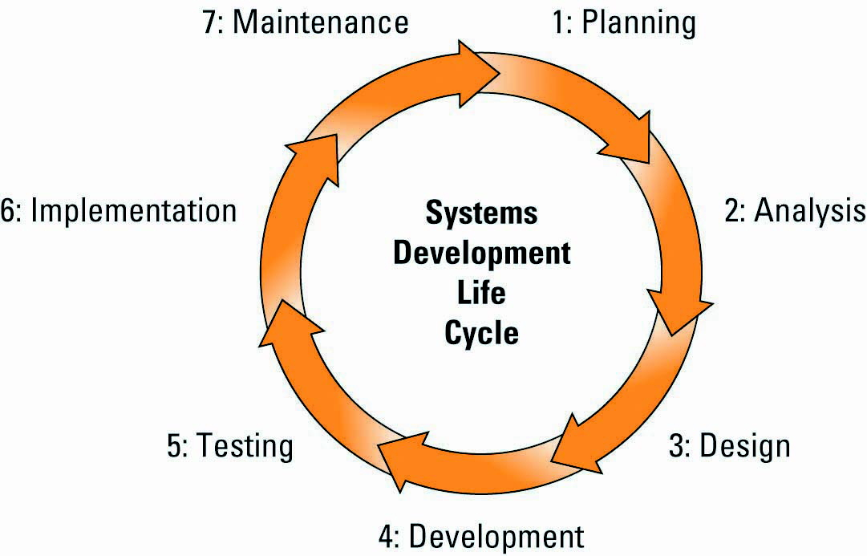
The Systems Development Life Cycle (SDLC)
Systems development life cycle (SDLC) – the overall process for developing information systems from planning and analysis through implementation and maintenance
Notes:
CLASSROOM EXERCISE
Around SDLC
Break your students into groups and have them correlate the SDLC to building a house.
This activity helps students understand the different types of activities that occur during each phase of the systems development life cycle
Have your students present their answers to the entire class

Slide 19
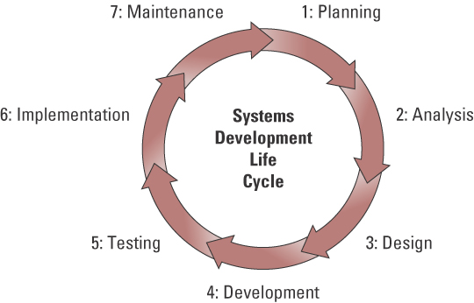
The Systems Development Life Cycle (SDLC)
Does system make sense?
Feasibility. Scheduling.
Convert from old
system to new system.
Fix, maintain, and
improve system.
How can system solve
business problem?
LAYPERSON language.
Test the system.
3 times the time and
resources of
programming!!
How can system solve
business problem?
TECHIE language.
Build the system.
Notes:
Class Activity: Break your students into groups and have them correlate the SDLC to building a house.
This activity helps students understand the different types of activities that occur during each phase of the systems development life cycle
Have your students present their answers to the entire class

Slide 20
The Systems Development Life Cycle (SDLC)
Planning phase – involves establishing a high-level plan of the intended project and determining project goals
Analysis phase – involves analyzing end-user business requirements and refining project goals into defined functions and operations of the intended system
  Business requirement – detailed set of business requests that the system must meet in order to be successful
Notes:
The SDLC and its associated phases are discussed in detail in the Systems Development Business Plug-In
CLASSROOM EXERCISE
Space Needle Exercise
Break your students into groups and give them equal materials from a Tinker Toy set, a Zome set, or a product of your choice. Give them each the following instructions and observe the groups as they build their prototypes.
Review the IM for details on the project

Slide 21
PLANNING: Assess Project Feasibility
Feasibility study – determines if the proposed solution is feasible and achievable from a financial, technical, and organizational standpoint
Different types of feasibility studies
  Economic feasibility study
  Operational feasibility study
  Technical feasibility study
  Schedule feasibility study
  Legal and contractual feasibility study
Notes:
Economic feasibility study – (cost-benefit analysis) – identifies the financial benefits and costs associated with the systems development project
Operational feasibility study – examines the likelihood that the project will attain its desired objectives
Technical feasibility study – determines the organization’s ability to build and integrate the proposed system
Schedule feasibility study – assesses the likelihood that all potential time frames and completion dates will be met
Legal and contractual feasibility study – examines all potential legal and contractual ramifications of the proposed system
Which type of feasibility study would be appropriate for each of the following:
Implementation of a new payroll system
Implementation of a new CRM system
Implementation of a new module to an existing CRM system
Implementation of a new ERP system
Implementation of a additional functionality to an existing KM system

Slide 22
Analysis: Examining Business Processes
Business process - a standardized set of activities that accomplish a specific task, such as processing a customer’s order
Business processes transform a set of inputs into a set of outputs (goods or services) for another person or process by using people and tools
Notes:
Waiting in line at a grocery store is a great example of the need for process improvement
In this case, the “process” is called checkout, and the purpose is to pay for and bag groceries
The process begins when a customer steps into line and ends when the customer receives the receipt and leaves the store
This simple example describes a customer checkout process
Can you name other business process?
Developing new products
Building a new home
Ordering clothes from mail-order companies
Requesting new telephone service from a telephone company
Administering Social Security payments

Slide 23
Business Process Improvement
Continuous process improvement - attempts to understand and measure the current process, and make performance improvements accordingly
Business process reengineering (BPR) – “Blows away” the current processes, enables new ones. More radical change.
Notes:
Can you name an organization, product, or service that does not require any improvement?
This would be a perfect organization – does not exist
Is continuous process improvement a one-time event?
No, it is continuous

Slide 24
Business Process Improvement
Two types of BPI:
  Business Process Automation (BPA)- leaves the process alone (stays mostly the same), makes it more efficient, often using technology.
  Business process reengineering (BPR) – “Blows away” the current processes, enables new ones. More radical change.
Notes:
Can you name an organization, product, or service that does not require any improvement?
This would be a perfect organization – does not exist
Is continuous process improvement a one-time event?
No, it is continuous

Slide 25
Business Process Design
Business process modeling (or mapping) - the activity of creating a detailed flow chart or process map of a work process showing its inputs, tasks, and activities, in a structured sequence
Business process model - a graphic description of a process, showing the sequence of process tasks, which is developed for a specific
  As-Is process model
  To-Be process model
Notes:
Why is it important to diagram the As-Is process prior to diagramming the To-Be process?
It is important to understand the entire process from end-to-end before determining how to fix the process
What is the difference between the As-Is and To-Be process
As-Is process model - represents the current state of the operation that has been mapped, without any specific improvements or changes to existing processes
To-Be process model - shows the results of applying change improvement opportunities to the current (As-Is) process model

Slide 26
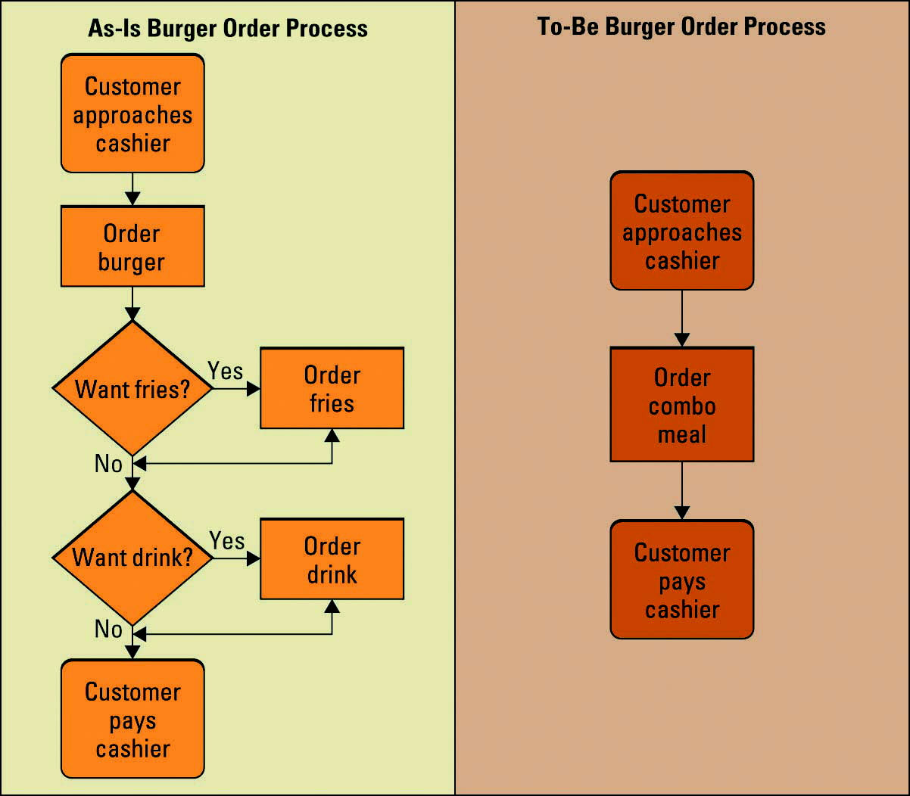
Business Process Design
Notes:
Ask your students if they can think of any other processes that have been reengineered
Pumping gas (pay at the pump)
Auto checkout at the grocery store
Bar codes

Slide 27
Example: Ford - BEFORE and After
Purchase
Order
Purchasing
Vendor
Receiving
Goods
Receiving
Document
Copy of
Purchase
Order
Payment
Invoice
Accounts
Payable
500 AP employees! Most time
spent on mismatches.

Slide 28
Example: Ford - Before and AFTER
Purchase
Order
Purchasing
Vendor
Receiving
Goods
Payment
Accounts
Payable
“Don’t send
us invoices”
Database
75% reduction in head count.

Slide 29
The Systems Development Life Cycle (SDLC)
Design phase – involves describing the desired features and operations of the system including screen layouts, business rules, process diagrams, pseudo code, and other documentation
Development phase – involves taking all of the detailed design documents from the design phase and transforming them into the actual system
Notes:
The SDLC and its associated phases are discussed in detail in the Business Plug-In Systems Development
CLASSROOM EXERCISE
Campus of the Future
A $61 million dorm development project at the University of Hawai'i-Manoa is being called an example of "the future of residence halls" at a local gathering of national higher education officials.
As the demolition of Frear Hall began yesterday on the UH-Manoa campus, plans for its replacement received praise from some members of the Association of College and University Housing Officers, made up of campus housing officials from across the nation, for its sustainable and student-friendly design.
For the rest of the article follow this link: http://www.honoluluadvertiser.com/apps/pbcs.dll/article?AID=/20060711/NEWS0701/607110340/1013/NEWS

Slide 30
The Systems Development Life Cycle (SDLC)
Testing phase – involves bringing all the project pieces together into a special testing environment to test for errors, bugs, and interoperability and verify that the system meets all of the business requirements defined in the analysis phase
Implementation phase – involves placing the system into production so users can begin to perform actual business operations with the system
Notes:
The SDLC and its associated phases are discussed in detail in the Business Plug-In Systems Development

Slide 31
The Systems Development Life Cycle (SDLC)
Maintenance phase – involves performing changes, corrections, additions, and upgrades to ensure the system continues to meet the business goals
Notes:
The SDLC and its associated phases are discussed in detail in the Business Plug-In Systems Development

Slide 32
Regardless of your major, you will be involved in Steps 1, 2, 5, 6 and 7
Technology is a huge part of business and our world in general.
You can’t “not like computers” anymore and survive.
Minimally, you need to understand technology and its consequences for business and life.
That’s true even if you outsource!

Slide 33
What’s “outsourcing”?
Generally that means your organization is not able/willing to complete steps 3 and 4.
You STILL will be involved in 1, 2, 5, 6 and 7.
Even if your hire a consultancy you can’t escape completely!!

Slide 34
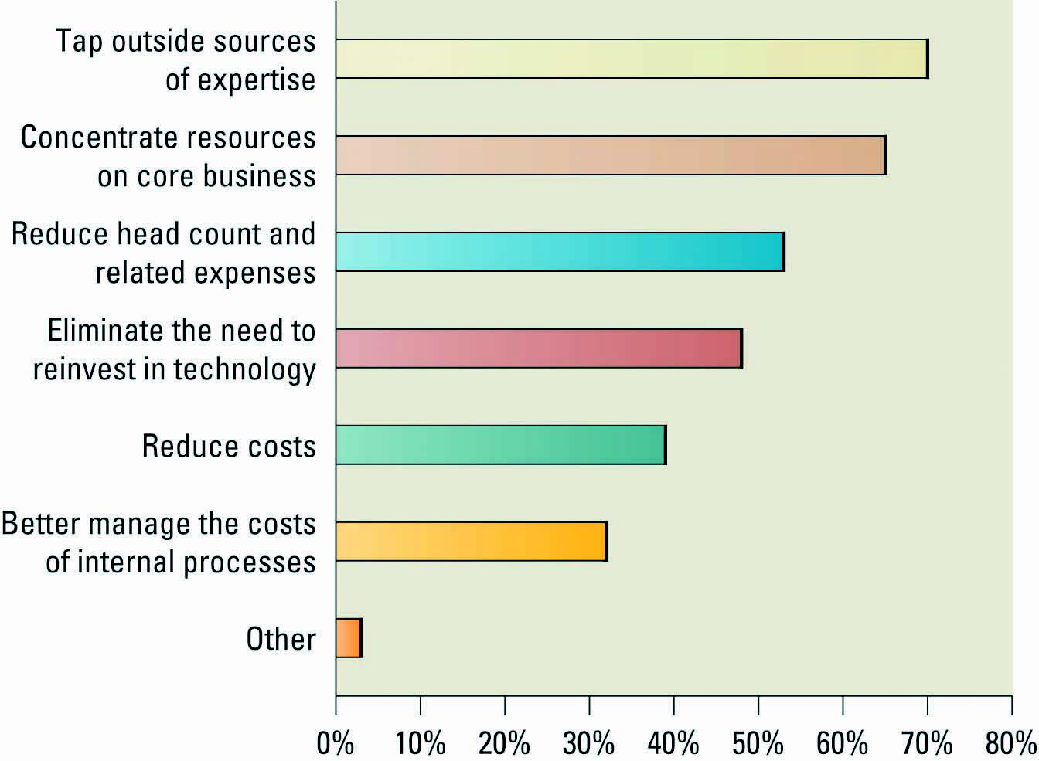
Outsourcing
Reasons companies outsource
Notes:
Tom Friedman on the Daily Show
http://www.comedycentral.com/motherload/index.jhtml?ml_video=70490 (takes a while to load).

Slide 35
Sourcing’s New Surge - Offshoring
Offshore outsourcing – using organizations from developing countries to write code and develop systems
According to Forrester Research, nearly half of all businesses use offshore providers, and two-thirds plan to send work overseas in the near future
Notes:
Numerous countries have substantially well-trained IT professional and clerical staff who have lower salary expectations compared to their U.S. counterparts

