Slide 1
OMIS 351 Unit 2 (of 7) Strategic Tools, Frameworks and Ideas to Make Unit 1 Happen

Slide 2
The Danger of Relying on Technology
Firms strive for sustainable competitive advantage, financial performance that consistently outperforms industry averages
Achieving sustainable competitive advantage is not easy
Rapid emergence of new products and new competitors
New competitors and copycat products cutting costs, prices and increasing features that may benefit customers but erode profits industry-wide

Slide 3
The Danger of Relying on Technology
Achieving sustainable competitive advantage is more difficult when competition involves technology
The fundamental strategic question in the Internet era:
“How can I possibly compete when everyone can copy my technology and the competition is just a click away?”

Slide 4
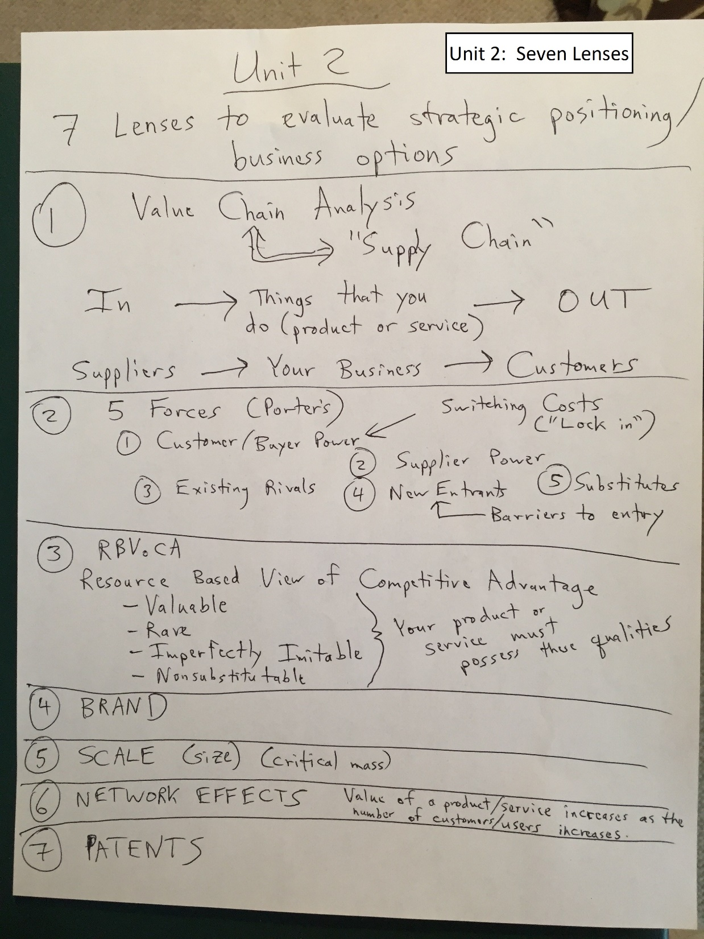

Slide 5
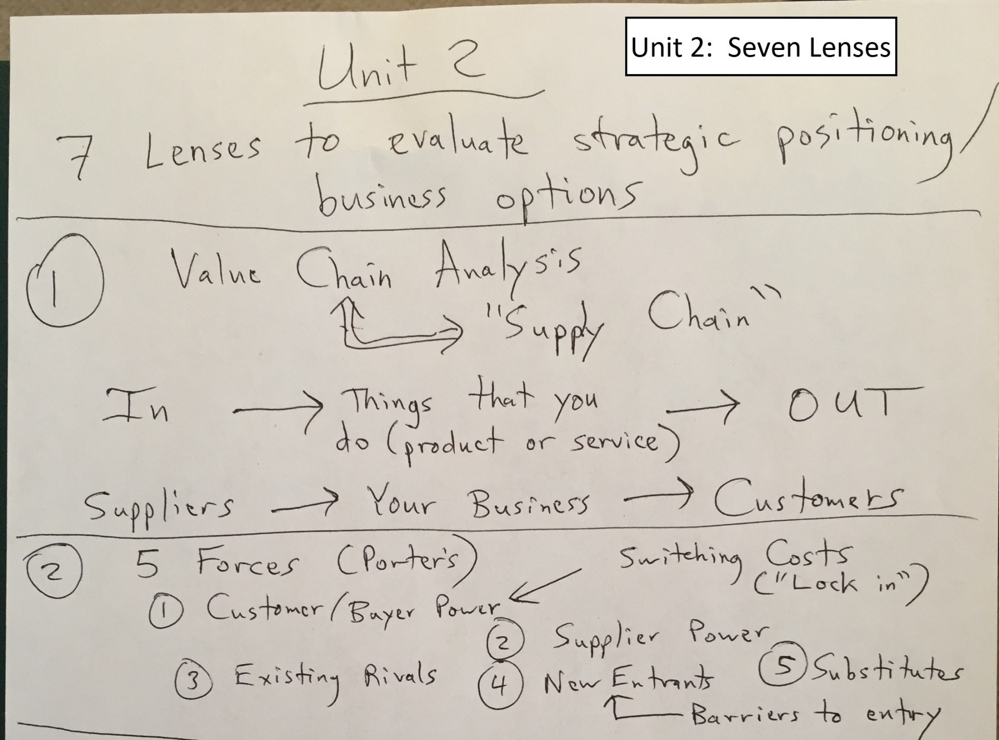

Slide 6
The Danger of Relying on Technology
Two concepts defined by Michael Porter can be useful in achieving sustainable advantage
Value chain
Five forces
According to Porter, firms suffer aggressive, margin-eroding competition because they define themselves according to operational effectiveness rather than strategic positioning

Slide 7
The Value Chain

Slide 8
Key Framework: The Value Chain
Dell stopped deployment of the logistics and manufacturing modules of a packaged ERP implementation — It realized that the software would require the firm to make changes to its unique and highly successful operating model
Apple adopted third-party ERP software because the firm competes on product uniqueness rather than operational differences

Slide 9
Key Framework: The Five Forces of Industry Competitive Advantage
In markets where commodity products are sold, the Internet can increase buyer power by increasing price transparency
The more differentiated and valuable an offering, the more the Internet shifts bargaining power to sellers
Price transparency: The degree to which complete information is available
Information asymmetry: A decision situation where one party has more or better information than its counterparty

Slide 10
Competitive Environment: Porter’s Forces Model
Threat of
New Entrants
Bargaining
Power of
Suppliers
Rivalries within
Industry
Bargaining
Power of
Customers
Threat of
Substitutes
Notes:
3
3

Slide 11
Competitive Environment: Porter’s Forces Model
Threat of
New Entrants
Bargaining
Power of
Suppliers
Rivalries within
Industry
Bargaining
Power of
Customers
Threat of
Substitutes
Regulatory
Notes:
4
4

Slide 12
Barriers to Entry, Technology, and Timing
The barriers to entry for many tech-centric businesses are low
Market entry is not the same as building a sustainable business and just showing up doesn’t guarantee survival
Timing and technology alone will not yield sustainable competitive advantage — Both can be enablers for competitive advantage
Moving first pays off when the time lead is used to create critical resources that are valuable, rare, tough to imitate, and lack substitutes

Slide 13
The Danger of Relying on Technology
Operational effectiveness: Performing the same tasks better than rivals perform them
The danger in operational effectiveness is “sameness”
This risk is acute in firms that rely on technology for competitiveness
Buy the same stuff as your rivals
Hire students from the same schools
Copy the look and feel of competitor Web sites
Reverse engineer their products

Slide 14
The Danger of Relying on Technology
Fast follower problem: Exists when savvy rivals watch a pioneer’s efforts, learn from their successes and missteps, then enter the market quickly with a comparable or superior product at a lower cost before the first mover can dominate
Technology can be matched quickly — Rarely a source of competitive advantage

Slide 15
The Danger of Relying on Technology
Operational effectiveness is critical, but not sufficient enough to yield sustainable dominance over the competition
Strategic positioning: Performing different activities from those of rivals, or the same activities in a different way
Technology itself is often very easy to replicate, but it is essential to creating and enabling novel business approaches that are defensibly different and can be quite difficult for others to copy

Slide 16
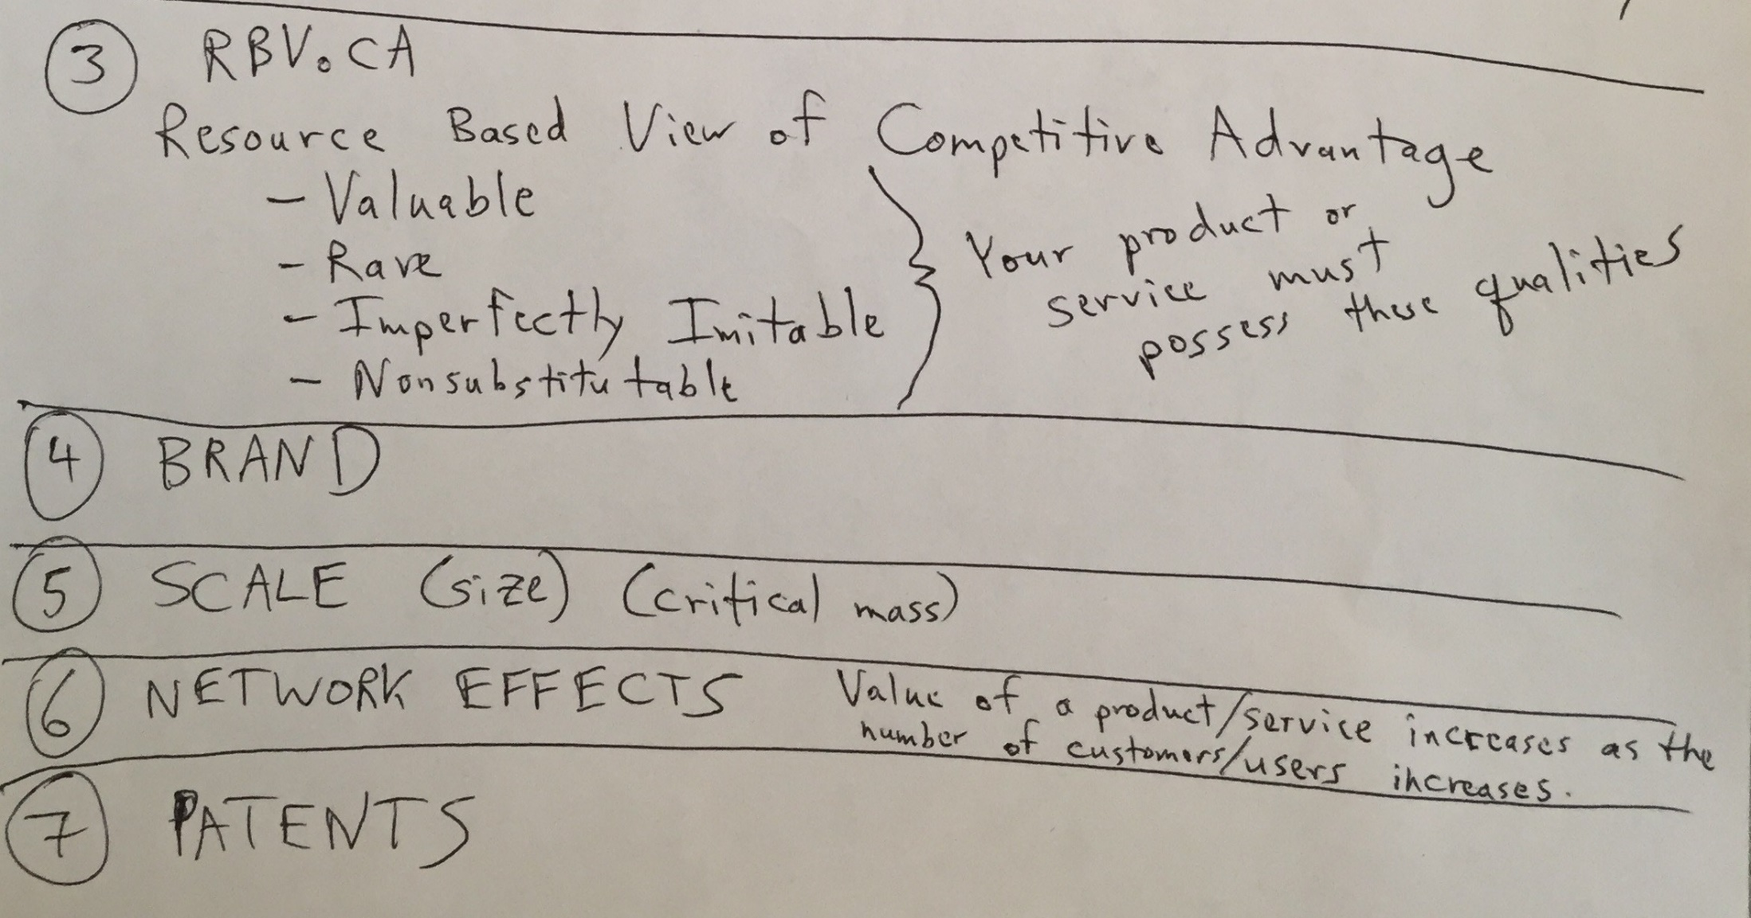

Slide 17
FreshDirect Redefines the NYC Grocery Landscape
The New York City–based grocery firm focused on the two most pressing problems for Big Apple shoppers:
Selection is limited
Prices are high
The solution it provides
Use technology to craft an ultraefficient model that makes an end-run around stores

Slide 18
FreshDirect Redefines the NYC Grocery Landscape
The FreshDirect model crushes costs that plague traditional grocers
Worker shifts are highly efficient
The firm buys and prepares what it sells, leading to less waste
Higher inventory turns
Use of artificial intelligence software
Use of climate controlled cold rooms to save energy
Use of recycled bio-diesel fuel to cut down on delivery costs

Slide 19
Powerful Resources: Imitation-Resistant Value Chains
FreshDirect
The elements in FreshDirect’s value chain work together to create and reinforce competitive advantages that others cannot easily copy
Incumbents would be straddled between two business models, unable to reap the full advantages of either
Straddling: When a firm attempts to match the benefits of a successful position while maintaining its existing position
Late-moving pure-play rivals will struggle, as FreshDirect’s lead time allows it to develop brand, scale, data, and other advantages that newcomers lack

Slide 20
Resource-based view of competitive advantage
How can you recognize whether your firm’s differences are special enough to yield sustainable competitive advantage?
Resource-based view of competitive advantage
The strategic thinking approach suggesting that if a firm is to maintain sustainable competitive advantage, it must control an exploitable resource, or set of resources, that have four critical characteristics
Valuable
Rare
Imperfectly imitable
Nonsubstitutable

Slide 21
Powerful Resources: Brand
Brand: The symbolic embodiment of all the information connected with a product or service
A strong brand can be an exceptionally powerful resource for competitive advantage
Consumers use brands to lower search costs
How do you build a strong brand?
A strong brand proxies quality and inspires trust
Technology can play a critical role in rapidly and cost-effectively strengthening a brand

Slide 22
Powerful Resources: Scale
Scale
Scale advantages: Advantages related to a firm’s size
Businesses benefit from economies of scale
Economies of scale: When the cost of an investment can be spread across increasing units of production or in serving a growing customer base
A growing firm may gain bargaining power with its suppliers or buyers
2-22

Slide 23
Powerful Resources: Switching costs and Data
Switching costs: Exist when consumers incur an expense to move from one product or service to another
Sources of switching costs:
Learning costs
Information and data
Financial commitment
Contractual commitments
Search costs
Loyalty programs
Data can be a particularly strong switching cost for firms leveraging technology

Slide 24
Powerful Resources
Differentiation
Commodities are products or services that are nearly identically offered from multiple vendors
To break the commodity trap, many firms leverage technology to differentiate their goods and services
Network effects: When the value of a product or service increases as its number of users expands
Distribution channels: The path through which products or services get to customers

Slide 25
Powerful Resources: Patents
Intellectual property protection can be granted in the form of a patent for those innovations deemed to be useful, novel, and nonobvious
Firms that receive patents have some degree of protection from copycats that try to identically mimic their products and methods
Patents are not necessarily a sure-fire path to exploiting an innovation.

Slide 26
Strategy Case Study: Zara
Zara: Game-changing clothes giant
Parent company: Inditex Corporation
The blend of technology-enabled strategy unlashed by Zara seems to break all of the rules in the fashion industry
The firm shuns advertising and rarely runs sales
In fashion industry nearly every major player outsources manufacturing to low-cost countries, but Zara is highly vertically integrated, keeping huge swaths of its production process in-house

Slide 27
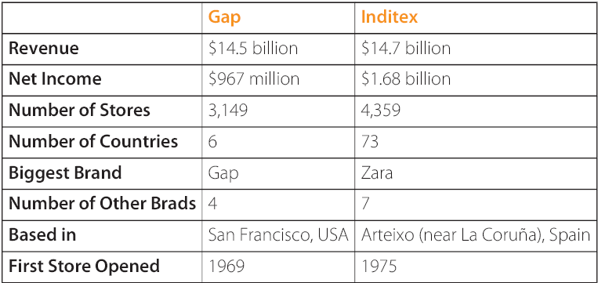
Gap versus Inditex at a Glance

Slide 28
Why Study Zara?
To understand and appreciate :
The counterintuitive and successful strategy of Zara
The technology, which has made all of this possible

Slide 29
Contract Manufacturing: Lower Costs at What Cost?
Conventional wisdom suggests that leveraging cheap contract manufacturing in developing countries can keep the cost of goods low
Contract manufacturing: Involves outsourcing production to third-party firms
Firms that use contract manufacturers don’t own the plants or directly employ the workers who produce the requested goods
Firms can lower prices and sell more product or maintain higher profit margins

Slide 30
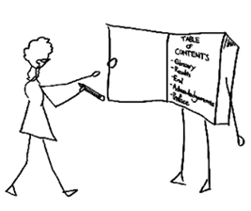
Contract Manufacturing: Lower Costs at What Cost?
The downside of contract manufacturing
In order to have the low-cost bid, contract firms:
Skimp on safety
Ignore environmental concerns
Employ child labor
Engage in some ghastly practices

Slide 31
Contract Manufacturing: Lower Costs at What Cost?
Firms that fail to adequately ensure their products are made under acceptable labor conditions risk a brand-damaging backlash that may:
Turn off customers
Repel new hires
Leave current staff feeling betrayed

Slide 32
Don’t Guess, Gather Data
To make sure that the stores carry the kinds of products customers want, Zara managers ask the customers
Zara’s store managers are armed with personal digital assistants (PDAs) that can be used to:
Gather customer input
Chat up with customers to gain feedback on what they’d like to see more of
Incentives for success—as much as 70 percent of salaries can come from commissions

Slide 33
Don’t Guess, Gather Data
Staff also checks for customer preferences by looking at unsold items
PDAs are linked to the store’s point-of-sale (POS) system
Point-of-sale (POS) system: A transaction process that captures customer purchase information, showing how garments rank by sales
Managers can send updates that combine the hard data captured at the cash register with insights on what customers would like to see

Slide 34
Don’t Guess, Gather Data
All of this valuable data allows the firm to plan styles and issue rebuy orders based on feedback rather than hunches and guesswork
The goal is to improve the frequency and quality of decisions made by the design and planning teams

Slide 35
Design
Zara designs follow evidence of customer demand
Zara design staff consists of young and fresh designers from design school
Teams are regularly rotated to:
Cross-pollinate experience
Encourage innovation

Slide 36
Manufacturing and Logistics
The average time for a Zara concept to go from idea to appearance in store is fifteen days versus their rivals who receive new styles once or twice a season
The firm is able to be so responsive through:
A competitor-crushing combination of vertical integration and technology-orchestrated coordination of suppliers
Just-in-time manufacturing
Finely tuned logistics

Slide 37
Manufacturing and Logistics
Vertical integration: When a single firm owns several layers in its value chain
Value chain: The set of interdependent activities that bring a product or service to market
Nearly 60 percent of Zara’s merchandise is produced in-house, with an eye on leveraging technology in areas that:
Speed up complex tasks
Lower cycle time
Reduce error

Slide 38
Stores
Running out of bestsellers at Zara delivers several benefits:
Allows the firm to cultivate the exclusivity of its offerings
Encourage customers to buy right away and at full price
Encourages customers to visit often
Reduces the rate of failed product introductions

Slide 39
Technology ≠ Systems. Just Ask Prada
Zara’s IT expenditure is less than one-fourth the fashion industry average
Zara excels by targeting technology investment at the points in its value chain where it will have the most significant impact
Zara makes sure that every dollar spent on tech has a payoff

Slide 40
Technology ≠ Systems. Just Ask Prada
The Prada example offers critical lessons for managers:
Getting the right mix of the following five components is critical to executing a flawless information system rollout:
Hardware
Software
Data
Procedures
People
Financial considerations should forecast the return on investment (ROI) of any effort
Designers need to thoroughly test the system before deployment

Slide 41
Moving Forward
Zara’s value chain is difficult to copy, but it still has challenges to face
Limitations of Zara’s Spain-centric, just-in-time manufacturing model:
If problems occur in northern Spain, Zara has no other fall back
The firm is potentially more susceptible to financial vulnerabilities as the Euro has strengthened relative to the dollar
Rising transportation costs
Zara’s financial performance can also be impacted by broader economic conditions

Slide 42
Moving Forward
Zara’s value chain is difficult to copy; but it is not invulnerable, nor is future dominance guaranteed
Zara’s management must
Have an understanding of how information systems can enable winning strategies
Scan the state of the market and the state of the art in technology, looking for new opportunities and remaining aware of impending threats

