Slide 1
OMIS 351 Unit 5 (of 7) Social Media, Peer Collaboration and Production, and The Sharing Economy

Slide 2
Web 1.0—The Old Web
See what a familiar Web page looked like in the early days of the Internet.
Visit http://www.archive.org and view archival versions of over 150 billion Web pages from the past.

Slide 3
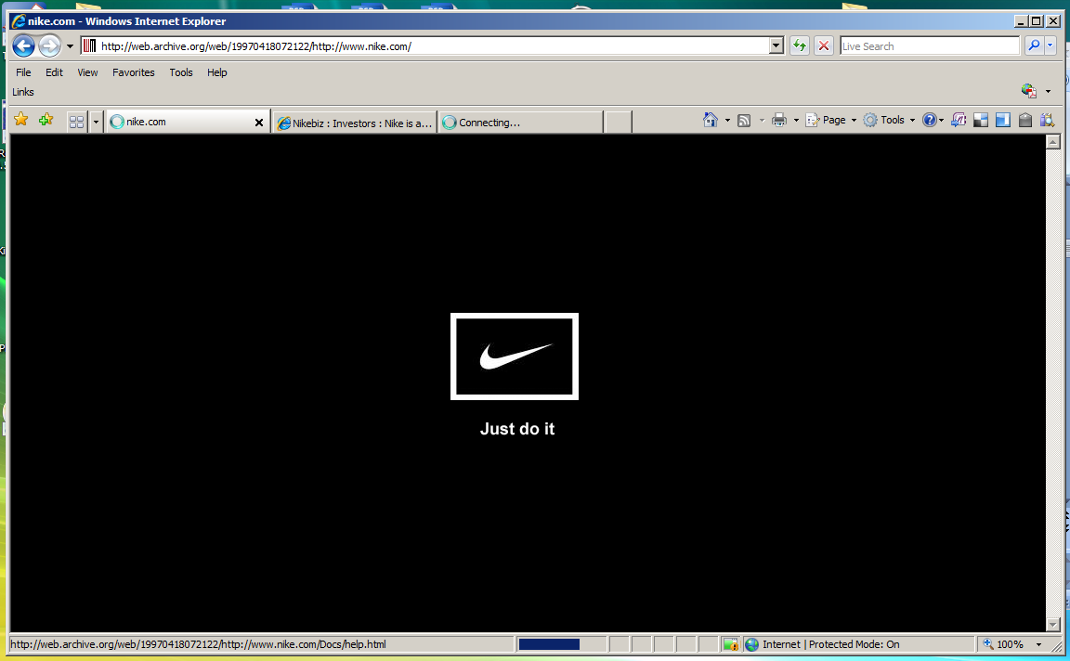
Web 1.0
The first generation of Web pages often contained electronic versions of traditionally printed material and was sometimes called brochureware.
A 1997 Nike.com Web page

Slide 4
Web 2.0
Today’s Web sites are highly interactive, providing customers with highly personalized experiences tailored to their specific needs.
Nike.com today

Slide 5
Nike—Then and Now
Then:
View a list of shoes.
View a list of stores.
Find a phone number, an e-mail address, or a mailing address.
Read about the company.
Now:
Watch a video about your favorite sport.
Build and buy your own customized shoes.
Participate in an online community of athletes.

Slide 6
User-Generated Content
Peer production is when users collaboratively work to create content and provide services online.
Web 1.0 sites had a single author and voice (the company).
Web 2.0 sites have multiple voices, enabling a wider community to participate.

Slide 7
Blogs
Blogs provide an easy way for a broad, but limited number of authors to publish content online.
Free blogging services have made this a popular medium.

Slide 8
Wikis
Wikis are Web sites that can be edited by anyone.
Wikis expand authorship to everyone.
Wikipedia is one of the world’s most popular Web sites.

Slide 9
Social Networks
Social networks are online communities that allow users to create profiles and communicate with other users.
Sites like Facebook provide the tools that allow users to create the content.
In some Web 2.0 sites, the company has no direct voice or authorship.

Slide 10
The Blue Shirt Nation
Best Buy is an early pioneer in using social networking to connect thousands of employees across the country.
Watch an interview with the creators of Best Buy’s Blue Shirt Nation social media site.
http://www.youtube.com/watch?v=49W2j2huIjg

Slide 11
Twitter
Sites like Twitter allow individuals to post continual updates to a network of followers.
Follow a politician, your favorite business reporter, or a sports figure like Chad Ochocinco and make sure you’re getting their latest news.

Slide 12
Mash-Ups
A mash-up is a combination of two or more data feeds into a single tool.
Ucrime.com combines crime data with Google Maps technology to create customized crime maps for any college campus.

Slide 13
RSS
Really simple syndication (RSS) technology allows users to combine news, blog feeds, and other information into their own customized newspaper.
Sites, apps and browsers allow users to create their own customized home pages, combining any content published through RSS.

Slide 14
Wisdom of Crowds
It’s what we have in OMIS 351 with Participation Quizzes and quizzes… quick feedback.
You give me a “prediction market”
This all becomes far more powerful with the large numbers of online users.
Then instead of “outsourcing” we get “crowdsourcing”.

Slide 15
Crowds are powerful: Be SMART
Social Media Awareness and Response Team
Watch out for Fatty, sock puppets and astroturfing!

Slide 16
Why study Facebook?
Understanding Facebook can help us better understand how Web 2.0 works for consumers, web companies, and advertisers.

Slide 17
Friends = Value
The more friends you have on Facebook, the more value the site provides.
Facebook provides tools that bring users together. What users do is up to them.

Slide 18
Social Graph
The global mapping of users, organizations, and how they are connected is called the social graph.
The term was coined by Mark Zuckerberg, founder of Facebook.
YOU are at the center of YOUR social graph.

Slide 19
Where Do All My Pictures Go?
Facebook content is hosted in huge data centers across the world.
These cloud computing applications are accessible through any Internet connection.
Data centers use as much energy each year as 5.8 million households!

Slide 20
Programming in the Clouds
Software as a service (SaaS)
On demand software
Application service provider (ASP)
Social networking sites aren’t the only ones who are moving to the clouds. Many traditional software companies are creating software that be used online without being installed on a user’s computer.

Slide 21
On Demand Software Comparison
Traditional Software
Software installed on user’s computer.
Software normally purchased up-front.
Customer responsible for data security and backup.
Software updates must be installed on local computer.
On Demand
Software accessed over the Internet.
Monthly subscription fees common.
Software company responsible for data security and backup.
Software updates occur at company.

Slide 22
Facebook Apps
Facebook users derive additional value through online apps, which people can use for free or a small fee.
You can play word games such as Scramble or Word Jumble and share with friends who also like word games.

Slide 23
APIs
Facebook’s Application Programming Interface (API) represents the instructions programmers can follow to create and post applications on the site.
Facebook has an incentive to create user-friendly APIs:
to make it as easy as possible for developers to create and post apps to the network.

Slide 24
Google Advertising
Google’s search engine advertisements that are displayed during a consumer’s search are based on the key words typed into the search engine.
Google gets a 2% click through rate (CTR).
Google gets paid every time a consumer clicks on a sponsored link.

Slide 25
Facebook Advertising
Facebook advertisements get the much lower CTR of 0.04%—compared to Google’s 2% CTR.
Unlike Google, Facebook ads aren’t directly related to a person’s visit.
Google ads are contextual, while Facebook’s are merely adjacent.

Slide 26
New Ad Models
Marketers need to rethink how they advertise to take advantage of the social graph.
Advertisers hope to reach many consumers with similar interests.
Services like Sony’s Music Box allow Facebook users to share music with friends with similar tastes.

Slide 27
Facebook and Privacy
Social networks have no effective way to screen or verify users.
People may not always be who they seem, giving a new meaning to “don’t talk to strangers.”
?
Who is the real “fluffybunny33”?

Slide 28
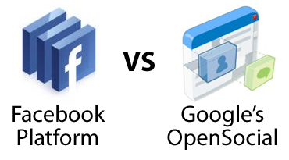
Open Networks
Will Facebook be able to continue it’s dominance?
Google’s OpenSocial API offers the potential to connect various social networks.
Can an open platform compete with Facebook?

