Slide 1
OMIS 351
Unit 3 (of 7)
IT Foundations I – Hardware & Software

Slide 2
Computer Hardware
Central Processing Unit
Control
Unit
ALU
Input
Devices
Output
Devices
Primary Storage
Unit
Secondary
Storage
Devices
Notes:
25

Slide 3
Notes:
26

Slide 4
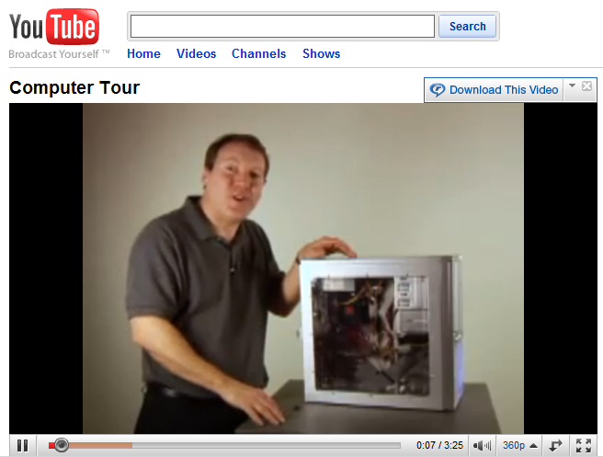
What’s Inside?
Motherboard
CPU
Ram
Video Card
Power Supply
Hard Disk
Optical Drive
Take an online tour at
http://www.youtube.com/watch?v=VWzX4MEYOBk

Slide 5
Lowest Level - Bits and Bytes
Data....Digital Signals
0011 0010
1110 0110
1011 1111
Cat...
Bit - Binary Digit (0,1)
Byte - Eight Bits
ASCII-American Standard Code for Information Interchange
Notes:
45

Slide 6
Information Technology Hardware
Computer Categories – Smart phone, Tablet, Notebook, Desktop, Mini, Mainframe, Super.
Evolution.
Notes:
27

Slide 7
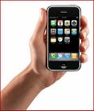
Categories – smart phones
Smart phones represent a technological leap, moving computing from the desktop or laptop and into the palm of your hand… wherever that is!

Slide 8

Categories – tablets (e.g., Ipad)
Computers and computing power are constantly improving.
New technologies, including
smart phones and the new iPad
are revolutionizing how we think
about computers.

Slide 9
Classes of Computer – Notebook/Desktop (“Micro” computer)
Smallest type of computer. Personal Computer, “PC”.
Cheapest computing power.
Generally slower than Mainframes and Minis.
Notes:
28

Slide 10
Processing Concepts
Internal
Word Size
The Intel Architecture
Central Processing Unit
Clock Speed MHz
(Millions of Cycles / second)
Internal Word Size (16, 32, or 64 bits)
(Internal Processing Capability / Clock Cycle)
Math
Co Processor
External
Word Size
Bus (Mother Board)
Auxiliary
I/O
Processor
Auxiliary
Display Processor
Hard
Disk
Random Access
Memory (RAM)
Video
abcd efg
Notes:
29

Slide 11

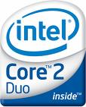
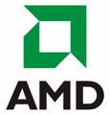
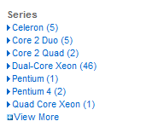
So Many Choices!
Each time you shop for a computer there are different CPUs (chips) available.
Each chip generation represents added performance.

Slide 12
It All Works Together
Advances in chip technology don’t work alone.
Operating systems and software must be updated
(and re-written) to take advantage of the new capabilities.
CPU
Operating
System
Software

Slide 13
Classes of Computer – Notebook/Desktop (“Micro” computer)
Often serve as the “client” in Client/Server computing.
Have allowed for End-User computing.
Notes:
31

Slide 14
Classes of Computer - Minicomputer
Smaller than a mainframe, bigger than a micro (small filing cabinet).
Middle in expense as well.
Used more and more as “server” in Client/Server computing.
Middle of the three classes in speed.
ERP applications of today (e.g., SAP’s ERP) need at least the power of a mini/midrange
Notes:
32

Slide 15
Classes of Computer -Mainframe
Generally physically larger than minis and micros.
Generally faster (in processing speed) than minis and micros.
Require special care (water or air cooling, professional operation, etc.).
Often “host” in networked environment.
Most expensive (other than “super”).
Notes:
33

Slide 16
Classes of Computer -Mainframe
A dying breed or a continued comeback?
  $2+ Trillion invested worldwide
  100,000+ mainframes
  >50% made by IBM
  Cobol and EBCDIC
Notes:
34

Slide 17
Hardware
Host Systems/
Superservers
Client
Systems
Servers
Client
Systems
Client
Systems
Notes:
37
This slide corresponds to Figure 4.13 on p. 121 and relates to the material on pp. 120-122.
A network is a system of microcomputers linked together with telecommunications hardware and software. Networked computers draw additional computing power from the other computers on the network, which can include other microcomputers, minicomputers, and mainframes. Key concepts of networked computing include:
Distributed Processing. This is the ability to spread the processing requirements for a particular task around the network to take advantage of unused processing capacity.
Client. A client on a network is typically a microcomputer that serves an end user for most of her or his processing needs. Programs for the client and extra processing capacity are provided as needed by the network.
Server. A server is a host or central computer that is dedicated to managing the logistics of routing data, information, and processing capacity among the clients on the system. In small networks, the server might be a single PC. On larger networks, the server can be a minicomputer or a mainframe. In very large organizations, several networks might be served, each by their own minicomputer, which in turn, is linked to the host mainframe.
Telecommunications. Telecommunications is the use of networks of interconnected computers and peripheral devices to process and exchange data and information. Hardware such as modems allow computers at distant locations to share information over telephone lines. Network operating systems are software programs that control resource sharing and communications flow among computers and peripheral on a local area network (LAN).

Slide 18
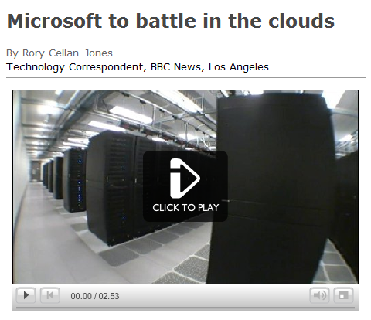
And Into The Clouds
Cloud computing moves computing processes or resources from the user’s machine onto the Internet.
Tour a cloud computing data center
http://news.bbc.co.uk/2/hi/technology/7693993.stm

Slide 19
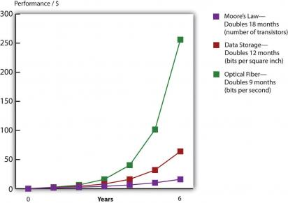
Moore’s Law
Processing speed,
storage capacity, and communication speed all continue to increase.
Moore’s Law states that the chip performance per dollar doubles every 18 months.

Slide 20
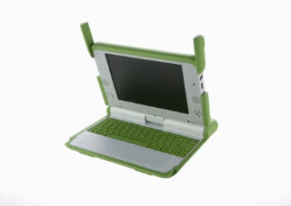
Global Impacts
The One Laptop Per Child initiative highlights how new grid networking technologies and efficient, solar-powered processors can bring technology to entirely new places.
Learn about the One Laptop Initiative
http://laptop.org/en/vision/index.shtml

Slide 21
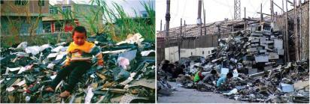
E-Waste
All this change also means tons and tons of electronic waste.
Unfortunately, much of this waste ends up overseas, where recycling or disposal bears high environmental and human costs.

Slide 22
Storage
Inventory data for your company contains product name (30 possible ASCII characters) and product description (50 possible ASCII characters). Unused positions in these two fields are padded with blanks. At any given point, you can have as many as 100,000 different products in inventory. Your IS manager has requested funding to purchase a 2 Gigabyte hard drive to store this data. What do you tell her?
Notes:
44

Slide 23
Storage
Bit, byte, Bill White.
Notes:
46

Slide 24
Storage
Magnetic Disk (hard and floppy). Cheap, direct access. Iomega Zip buoys this segment.
CD-ROM. 500+ Megabytes. Direct. Great for massive, non-changing data sets (e.g., encyclopedias). Low cost, long life.
DVD. 8x the capacity of CD-ROM (up to 17 Gigabytes).
Magnetic Tape. Sequential. Cheap but slow. Perishable. Bulky.
Flash memory device: small, plugs into USB.
Smart Cards.
Notes:
47

Slide 25
TELECOMMUNICATIONS DEVICES
Types of modems include:
  Telephone modems (dial-up)
  Cable modems
  Digital Subscriber Line (DSL) modems
  Wireless modems
  Satellite modems

Slide 26
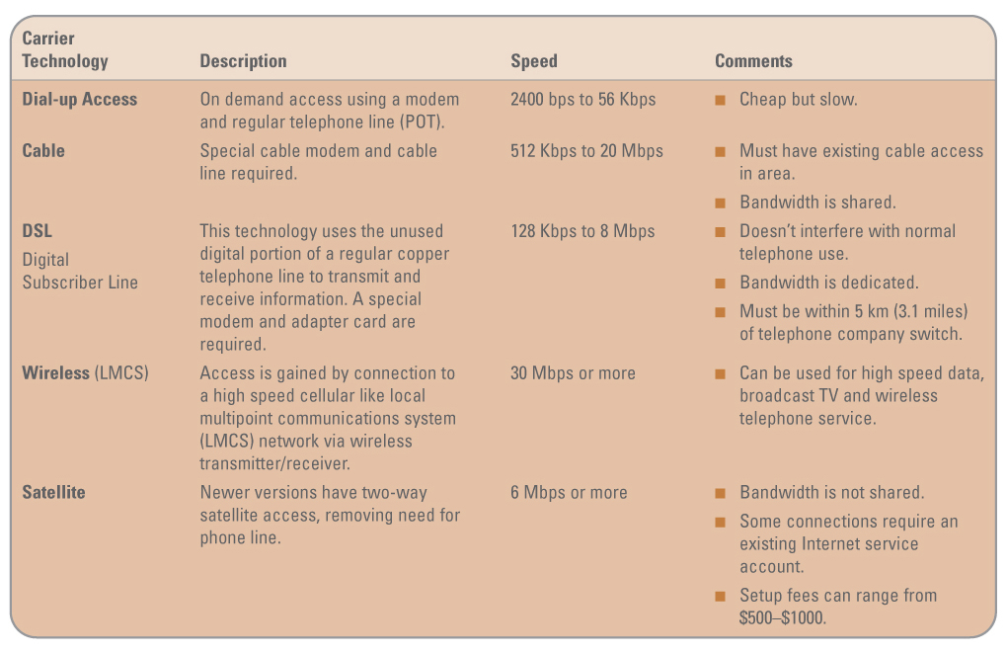
TELECOMMUNICATIONS DEVICES
Modem speed comparisons
Notes:
Modem speed comparisons

Slide 27
Information Technology Software
Control the machines
  Operating Systems (/utilities, etc.). Makes the 1’s, 0’s, and system hardware accessible: gateway is the “user interface”. Provide file, task, and resource management.
Get specific jobs done
  Application Programs. Spreadsheets, word processors, accounting packages, etc.
Notes:
1

Slide 28
Operating Systems
DOS. Runs under Windows 3.1 “environment” or alone. Now NT, 95, 98, 2000, 2003, XP, Vista, 7, 8, 10.
OS X. Macs.
UNIX. Portable to all classes.
Linux. Open source.
Notes:
2

Slide 29
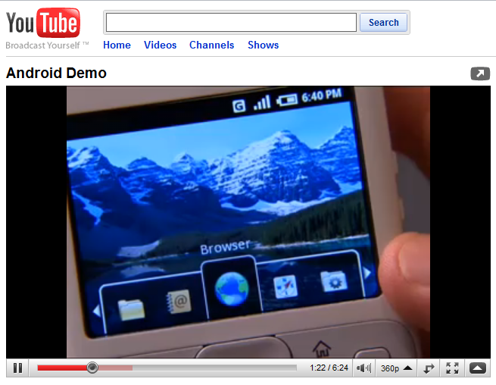
New Operating Systems
The movement to smart phones means that new operating systems and software need to be developed to get the most out of the new hardware and networks.
Hear what Android means
to software developers.
http://www.youtube.com/watch?v=1FJHYqE0RDg

Slide 30
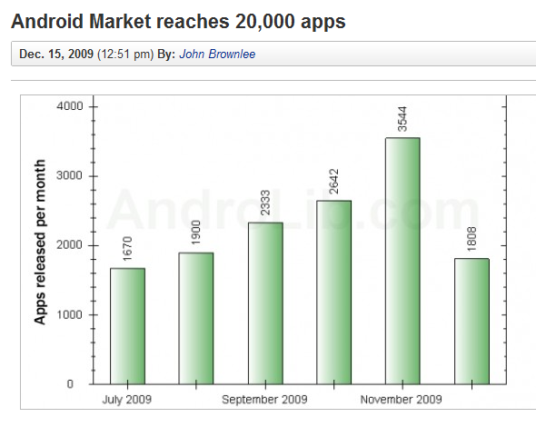

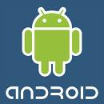
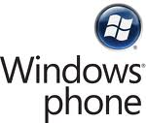
The OS Race
Apple, Google, Microsoft, and Blackberry are all racing to develop apps for their OS.
Each app increases the value of their platform (network effects).
Who will win?

Slide 31
Languages to Write Software - Evolution
1st Generation:
  Machine language. 1’s and 0’s.
2nd Generation:
  Assembler language. Low level instructions, e.g. LOD A, ADD B.
“Low Level”. More flexible, more efficient (from a machine standpoint).
Painful and tedious to work with (from a person’s standpoint).
Notes:
4

Slide 32
Languages to Write Software - Evolution
3rd Generation:
  BASIC, COBOL, etc. Use expressions closer to human dialogue: e.g., sum=total + newentry.
4th Generation:
  English like commands. Or, better, user specifies desired outcome, computer handles the rest. CASE, etc.
“High Level”. Less flexible, less efficient (from a machine standpoint). MUCH easier to use (from a person’s standpoint).
Notes:
5

Slide 33
OBJECT-ORIENTED PROGRAMMING
COMBINES DATA & PROCEDURES INTO A SINGLE OBJECT
PROGRAM SENDS MESSAGE TO OBJECT TO PERFORM EMBEDDED PROCEDURE
OBJECT’S DATA ENCAPSULATED FROM REST OF SYSTEM
CREATES REUSABLE CODE
REDUCES TIME AND COST OF WRITING SOFTWARE
Examples: Java and Visual Basic
*

Slide 34
But, COBOL!
Over 100 Billion lines of COBOL code is in use today.
This code cost over $2 Trillion to produce.
This code costs an estimated $30 Billion annually to maintain.
The Average Fortune 1000 company maintains 35 million lines of COBOL code.

Slide 35
What about the Web?
HTML: formatting specifications.
  “View”, “Document Source”
XML
Java, ActiveX
JavaScript, VBScript
ASP - “Active Server Pages”
Notes:
18

Slide 36
Application Software, Beyond Office
Groupware
Allows teams and groups to collaborate electronically.
  Reduce administrative costs
  Increase mobility and portability
  Respond to and add value for customers
  Support strategic direction
We’re really not doing well here… email still primary “groupware” app
Notes:
12

Slide 37
Enterprise Software
Enterprise software helps an entire organization work together!
  Supply chain management (SCM) helps firms manage aspects of its value chain.
  Customer relationship management (CRM) software supports customer-related sales and marketing activities.
  Business intelligence (BI) software provides reporting and decision support.

Slide 38

SAP ERP
SAP is a leading provider of enterprise resource planning (ERP) software.
ERP software allows large companies
to integrate data across platforms and across the world.
Learn how SAP’s ERP software can help streamline accounts payable processes.
http://www.sap.com/demos/demplayv2/demoPlayMaster.html?demos/ERP_Finance_US/ERP_Finance_US_config.xml

Slide 39

EDI – or “B2B”
Electronic data interchange (EDI) is the exchange of routine business transactions in a standardized computer processable format, covering such traditional applications as inquiries, planning, purchasing, acknowledgments, pricing, order status, invoices, and payments.
Read how the utility industry standardized billing and payment formats.
http://www.uig.org/

Slide 40
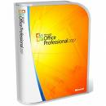
Software Economics
Software, like most forms of information, has high development costs but very low marginal costs of production.
If an extra copy of Word costs $1
to produce, how much should
Microsoft charge for it?

Slide 41
Traditional Model
Buy
Install
Update
Traditionally, software companies charged large up-front fees (i.e. purchase price)
and provided support over the life
of the software.

Slide 42
Software as a Service
Some software companies no longer charge for the product, but charge consumers as they use the service that the software provides.
Common terms:
  SaaS (software as a service)
  on-demand software
  application service provider

Slide 43
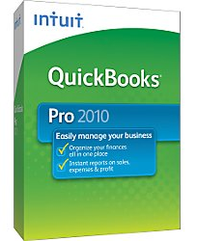
Comparison: QuickBooks
QuickBooks is a commonly used
business accounting and bookkeeping program.
Install Version
  $199 one time cost
  installed on your computer
  online updates installed automatically
  you are responsible for security and backup
Online Version
  $9.99 or $34.99/month
  accessed online
  no updates needed, updated on Web site
  multiple users can access account
  QuickBooks responsible for security and backup

Slide 44
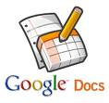
Pay Versus Free?
Google Documents provides word processing, spreadsheet, and presentation software that is similar to Microsoft Office.
Programs are free and available online.
Documents can be shared with anyone.
What does Microsoft think of Google Docs?

Slide 45
Software in the Clouds
Cloud computing: Replaces hardware & software in your location with services provided over the Internet
Cloud computing
has many attractive
attributes,
but its future
is still highly
uncertain.
Privacy??
Security??
Cost??
Service Levels??
Long Term Issues??
Watch a video on cloud computing
from a Google conference.
http://www.youtube.com/watch?v=ylBLVZykjgM

Slide 46

Open Source
Open source software
is available free of charge.
The source code,
or underlying programming, can be viewed or modified by anyone.
In contrast, the source code for Microsoft Word is owned by Microsoft.
It is illegal for anyone but Microsoft to modify it without permission.

Slide 47
Why Open Source?
The collaborative and open nature of open source software has many benefits:
  cost
  reliability
  security
  scalability
  agility and time-to-market

Slide 48
When Free Isn’t the Best Choice
There are many factors that determine the right software choice, not just
up-front costs:
  competitive advantage
  security
  legal issues
  reliability
  time/cost/resources

Slide 49
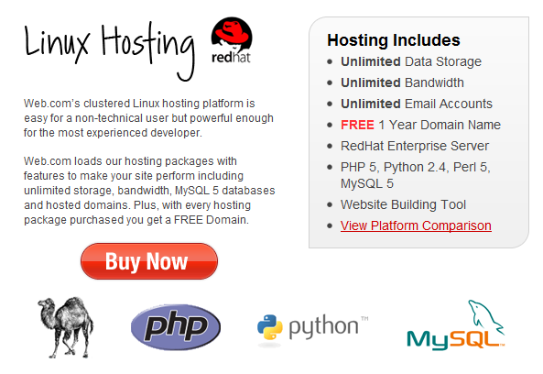
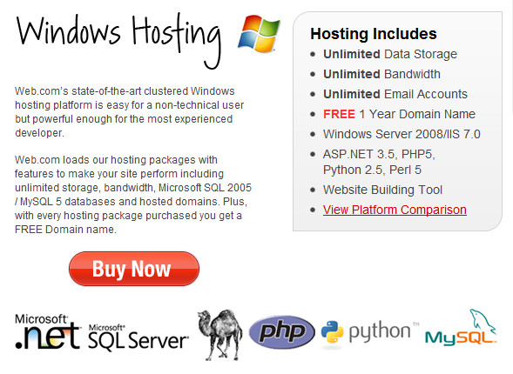
Web Hosting
Companies buying Web hosting solutions must choose between Windows and Linux.
The choice impacts the monthly cost,
but also the software and database tools your Web site can use.

