Slide 1
OMIS 351 Unit 7 (of 7) Internet Search, Internet Advertising, and Google

Slide 2
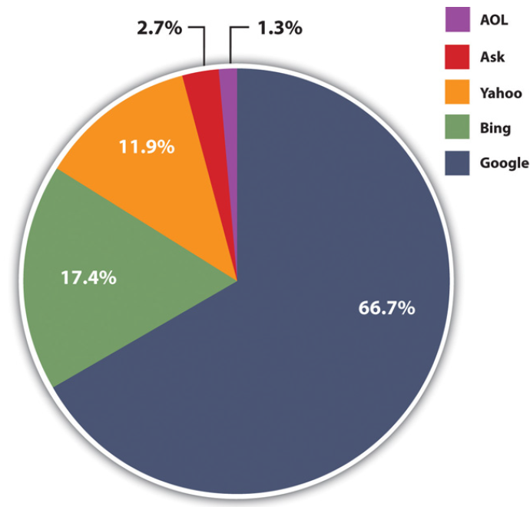
Google Is The Search King
Google is the dominant search provider… for now!
Microsoft’s BING! is on the rise.
Mobile advertising is still young; will Google continue its dominance?

Slide 3
Internet Ad Spending
Internet ad spending is on the rise.
Online advertising now competes with newspapers, TV, and other media.
Google’s 2020 advertising revenues
were about $144 BILLION

Slide 4
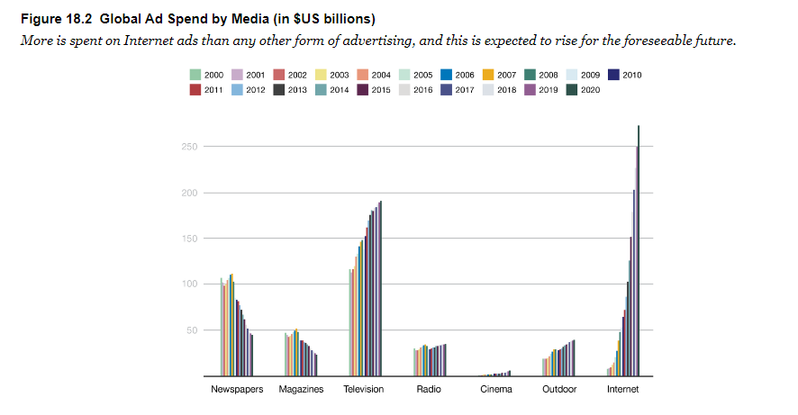
Internet Ad Spending
Google’s 2020 advertising revenues
were about $144 BILLION

Slide 5
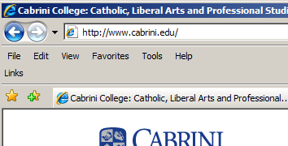
How Does Google Work?
Spiders crawl the Web, reading Web pages and reporting back to Google’s databases.
Your search terms are matched against the database using a proprietary algorithm.
Site information is read
from the Web site by spiders

Slide 6
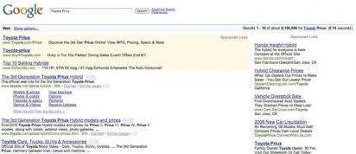
Natural and Sponsored Ads
Web sites that naturally rank high using Google’s algorithm are displayed in the main section and are free.
Sponsored ads appear in the top and right boxes; these advertisers pay.

Slide 7
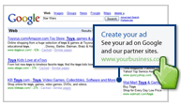
Trackability
Unlike magazines and TV, Internet ads can be tracked instantly.
Online tools allow advertisers to calculate ROI, test creativity, and adjust almost instantly.
Take a tour of Google Analytics!
http://www.google.com/analytics/tour.html

Slide 8
Spiders and Bots and Crawlers—Oh My!
When performing a search via Google or another search engine, you’re not actually searching the Web
Major search engines make a copy of the Web, storing and indexing the text of online documents on their own computers
To create these massive indexes, search firms use software to crawl the Web and uncover as much information as they can find
Software robots, spiders, Web crawlers: Software that traverses available Web links in an attempt to perform a given task
Search engines use spiders to discover documents for indexing and retrieval

Slide 9
Spiders and Bots and Crawlers—Oh My!
In order to make its Web sites visible, every online firm provides Domain Name Service (DNS) listings
Domain Name Service (DNS): Internet directory service that allows devices and services to be named and discoverable

Slide 10
What’s It Take to Run This Thing?
Google doesn’t disclose the number of servers it uses, but by some estimates, it runs over 1.4 million servers in over a dozen so-called server farms worldwide
Server farm: A massive network of computer servers running software to coordinate their collective use
Building massive server farms to index the ever-growing Web is now the cost of admission for any firm wanting to compete in the search market

Slide 11
Video Clip - Google’s Container Data Center
The video—Google container data center tour—is a virtual tour to one of Google’s data centers
To view the video, click here

Slide 12
Understanding the Increase in Online Ad Spending
There are three reasons driving online ad growth trends:
Increasing user time online
Improved measurement and accountability
Targeting

Slide 13
Search Advertising
Search engine marketing (SEM): The practice of designing, running and optimizing search-engine ad campaigns
Roughly two-thirds of Google’s revenues come from ads served on its own sites, and the vast majority of this revenue comes from search engine ads
Keyword advertising: Advertisements that are targeted based on a user’s query
Advertisers bid on the keywords and phrases that they’d like to use to trigger the display of their ad

Slide 14
Payment Methods
Cost per click (CPC): The advertiser pays each time a Web site visitor clicks on an ad.
Google charges this way.
Cost per thousand (CPM): The advertiser pays for every thousand times an ad is displayed.
Magazine advertising is paid for this way.
Cost per action (CPA): The advertiser pays each time a person does something (sale, lead, etc.)

Slide 15
Search Advertising
Text ads appearing on Google search pages are billed on a pay-per-click (PPC) basis
Pay-per-click (PPC): A concept where advertisers don’t pay unless someone clicks on their ad
Pay-per-click is sometimes used interchangeably with the term cost-per-click (CPC)
Cost-per-click (CPC): The maximum amount of money an advertiser is willing to pay for each click on their ad

Slide 16
Search Advertising
If no one clicks on an ad:
Google doesn’t make money
Advertisers don’t attract customers
Searchers aren’t seeing ads they’re interested in

Slide 17
Search Advertising
In order to create a winning scenario for everyone, Google has developed a precise ad ranking formula that rewards top performing ads by considering two metrics:
The maximum CPC that an advertiser is willing to pay
The advertisement’s quality score
Quality score: A broad measure of ad performance
Formula used by Google to determine the rank order of sponsored links appearing on search results pages
Ad Rank = Maximum CPC × Quality Score

Slide 18
Search Advertising
One factor that goes into determining an ad’s quality score is the click-through rate (CTR) for the ad
Click-through rate (CTR): The number of users who clicked an ad divided by the number of times the ad was delivered
Quality score also includes:
The overall history of click performance for the keywords linked to the ad
The relevance of an ad’s text to the user’s query
Google’s automated assessment of the user experience on the landing page
Landing page: The Web site displayed when a user clicks on an advertisement

Slide 19
Search Advertising
When an ad is clicked, advertisers don’t actually pay their maximum CPC
Google discounts ads to just one cent more than the minimum necessary to maintain an ad’s position on the page
Ad ranking and cost-per-click calculations take place as part of an automated auction that occurs every time a user conducts a search
Advertisers get a running total of ad performance statistics so that they can:
Monitor the return on their investment
Tweak promotional efforts for better results

Slide 20
Keywords with highest cost per click
Term | Rank | AVERAGE CPC
Structured settlement company | 1 | $455.05
New Mexico mesothelioma lawyers | 2 | $431.94
Mesothelioma trial lawyers | 3 | $399.47
Structured settlement money | 4 | $395.65
Structured settlement companies | 5 | $385.08
Source: Consolidated from SpyFu.com, June 2014.

Slide 21
Search Engine Optimization
Why pay for something you can get for free?
Search engine optimization (SEO) consultants specialize in setting up Web pages so they come up naturally… instead of paying!
123movers.com hard codes over 100,000 pages on their Web site, maximizing the chance that they’ll come up in natural results.

Slide 22
Ad Networks
Advertising networks help manage online advertising.
Publishers are Web sites that have space to sell.
Advertisers are companies who want to place ads.
Networks aggregate ad space, providing a valuable service.

Slide 23
More Formats
Affiliate Networks allow companies to pay commission on sales.
Lead Networks allow companies to pay for leads.
Their software allows companies like Macy’s to track visitors all the way through checkout, and pay commission on sales.
Their system allows Web sites to sell customer information to third parties, using co-registration programs.

Slide 24
Cookies
Cookies are small text files placed on your computer by Web sites you visit.
Cookies can help personalize a page, target advertising, or monitor traffic.
Welcome back, Cookie Monster!

Slide 25
Behavioral Targeting
Behavioral targeting leverages user behavior to charge higher ad rates to target customers, even when they’re on remnant pages.
Read how behavioral targeting increases online ad revenues!
http://www.akamai.com/dl/whitepapers/Insight_Brief_wp.pdf

Slide 26
Privacy Concerns
Online ads
are tied to the content of your incoming email.
Free services like Gmail offer great convenience, but some fear that Google may know too much!

Slide 27
Click Fraud
With billions of dollars at stake, some are tempted to find ways to cheat the system by registering false clicks.
Ad companies are constantly finding ways to prevent fraud.
IP address tracking
can be used to help ensure there’s not more than
one click per computer.

