Slide 1
OMIS 259
Procedures and Logistics
(How to succeed in OMIS 259)

Slide 2
What is “OMIS”?
OM&IS – “Operations Management and Information Systems”.
Watch the 2-minute video (also linked from our online schedule):
  https://www.youtube.com/watch?v=7g8yEeIzLUI&feature=youtu.be
OMIS 259 focuses on the building blocks of the “IS” (Information Systems) side of OM&IS (about 10% Web pages, about 45% Excel, about 45% Access)

Slide 3

“But I hate computers. I’m scared.”
OMIS 259 is here to help you.
We’ll start from the beginning
  …and move as fast as we can.
Now’s the time to “get over it”…
  … computers are going to be a part of your life!!

Slide 4

“But I know all of this. I’m BORED.”
No one knows everything.
  Not even your Professor.
On stuff you know, pad your grade.
  Practice business communication.
  Get OMIS 259 points for helping classmates!!
  Take days off!!

Slide 5
OMIS 259 can work for everyone!
Most of you will be somewhere in between.

Slide 6
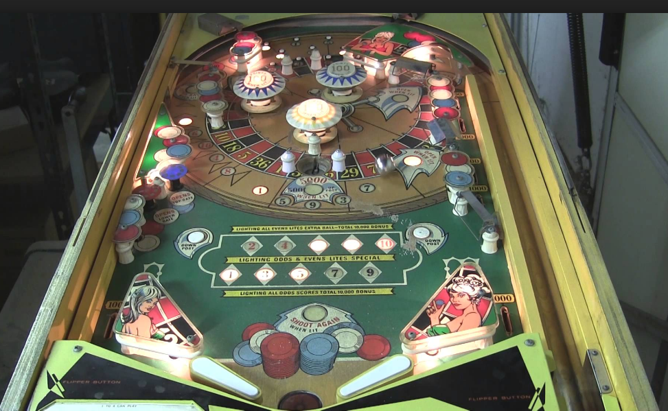

Well, maybe not EVERYONE…
Pinballs and Pitbulls…

Slide 7
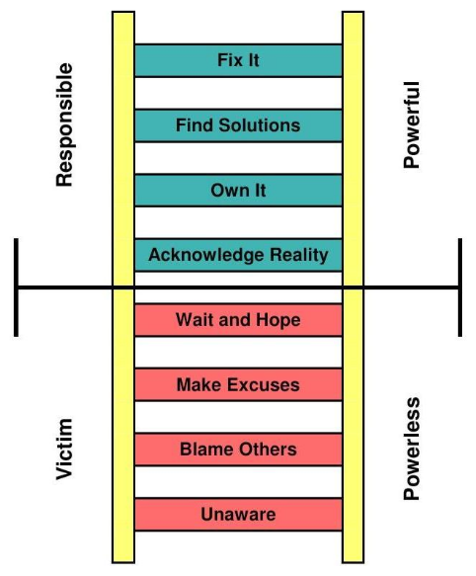
Pinballs and Pitbulls…

Slide 8
Course Web Site
Located at ChuckDowning.com (then choose OMIS 259)
Also linked within Blackboard
Most important part of web site is ONLINE SCHEDULE!
All the information you need for the class is on the site. Please look around, read the syllabus, the schedule, etc.
  Figures for quizzes, the syllabus, etc., are all found on our web page!

Slide 9
Communication
Communication to all students will be sent via email through Blackboard. Make sure your student email (znumber@students.niu.edu) is linked or forwarded to any email you check frequently.
You MUST check your email!

Slide 10
Course Structure
Entire course is shown on online schedule
  Organized by MyITLab chapter (see MyITLab video)
  You only need to purchase MyITLab for our course (ebooks are inside MyITLab). Financial aid students need to get this at the bookstore.
  Your Grade:
    35% MyITLab Exercises and Exams
    5% Participation
    5% Your Web Page
    30% Seven Quizzes (one drop permitted)
    25% Final Exam

Slide 11
Class Contract
No exceptions.
Working Technology is your responsibility.
You might not receive an email response.

Slide 12
No exceptions.
Explanation: You always have at least a full week to complete assignments. Please start early, as no make up or late work is accepted. Class policies outlined in the syllabus, the web page and on video are structured to be fair and lenient for you, but also so that the instructor and the TA(s) are not put in a position to judge which excuses are “good enough”. Please manage your semester within those policies. Please do not tell us why you missed an assignment, missed a quiz, did not do an assignment, etc. Students involved in official NIU activities who notify the instructor of the schedule of those activities at the beginning of the semester (e.g., athletes) must use all available drops, etc., first, and will be given make up opportunities beyond that. Other than that, all students are treated the same and we will NOT give you special consideration.

Slide 13
Working Technology is your responsibility.
In your business career, you will be expected to keep your own technology working. With a full week to complete assignments, you should be able to find an Internet connection and complete your assignments even if something goes wrong with your primary connection.

Slide 14
You might not receive an email response.
Explanation: No emails will be answered containing questions which are already answered on our web site. If you ask “Can I send a doctor’s note to excuse me from a quiz?”, “I forgot to complete an assignment… how can I get my points back?”, etc., you will simply not receive a response. Dr. Downing and his TA(s) are diligent as far as responding to emails, but if you are asking questions (“What’s the TA’s email address?”) whose answers are easily available on our web site, we will simply delete your email.

Slide 15
Getting Help and the Helper System
Dr. Downing and the TA are available via email for help, and synchronously via Collaborate on Blackboard (by appointment)
You are strongly encouraged (and your Participation grade will go up!, and you could even get a letter of recommendation from Dr. Downing) to seek and provide help to one another.
  Often a classmate’s explanation will be more clear than your professor’s (mine)
  If you do receive help, PLEASE go to the Helper System linked from the course web site, find the classmate who helped you and give them 1 point (these are dropdown choices within the system). Also, indicate what that classmate helped you with so others will know who is helpful.
  How you give and receive help is up to you. Email is a great start, but there are numerous other options.

